Slide 2
“There are two equal and opposite errors into which our race can fall about the devils. One is to disbelieve in their existence. The other is to believe, and to feel an excessive and unhealthy interest in them. They themselves are equally pleased by both errors…”
-- C.S. Lewis, The Screwtape Letters

Slide 3
Ephesians 6:17
Put on salvation as your helmet, and take the sword of the Spirit, which is the word of God.

Slide 4
Ephesians 6:18
Pray in the Spirit at all times and on every occasion. Stay alert and be persistent in your prayers for all believers everywhere.

Slide 6
Ephesians 6:12
For we are not fighting against flesh-and-blood enemies, but against evil rulers and authorities of the unseen world, against mighty powers in this dark world, and against evil spirits in the heavenly places.

Slide 7
With the Armor of God…
We battle for His Kingdom.

Slide 8
The time for judging this world has come, when Satan, the ruler of this world, will be cast out. -- John 12:31
“I don’t have much more time to talk to you, because the ruler of this world approaches. He has no power over me… -- John 14:30
Judgment will come because the ruler of this world has already been judged. – John 16:11

Slide 9
Luke 4:5-6
Then the devil took him up and revealed to him all the kingdoms of the world in a moment of time. “I will give you the glory of these kingdoms and authority over them,” the devil said, “because they are mine to give to anyone I please.

Slide 10
Satan, who is the god of this world, has blinded the minds of those who don’t believe. – 2 Corinthians 4:4
We know that we are children of God and that the world around us is under the control of the evil one. – 1 John 5:19

Slide 12
Mark 3:26-27
…if Satan is divided and fights against himself, how can he stand? He would never survive. Let me illustrate this further. Who is powerful enough to enter the house of a strong man and plunder his goods? Only someone even stronger—someone who could tie him up and then plunder his house.

Slide 13
1 Peter 3:19, 22
So he went and preached to the spirits in prison…Now Christ has gone to heaven. He is seated in the place of honor next to God, and all the angels and authorities and powers accept his authority.

Slide 14
“The war of the Lord is finished and the great blow is struck. Never again can Satan tempt Christ, as in the desert. Jesus is now Lord, Conqueror. But a war is not finished, a conflict does not cease with the striking of the decisive blow. The enemy remains with the scattered remnants of his army, and in pockets here and there a strong resistance may continue. That is the position of the church.”
-- Gustav Wingren

Slide 16
With the Armor of God…
We execute His will.

Slide 17
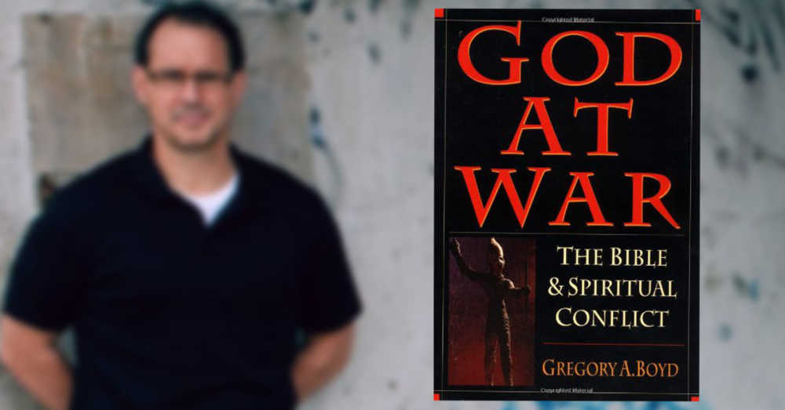

Slide 18
“Perhaps most tragically…we have surrendered a spiritual conflict we are commissioned to fight and ultimately win, for an intellectual puzzle we can never resolve…If instead we followed the example of our Savior, our basic stance toward evil in the world would be characterized by revolt, holy rage, social activism and aggressive warfare—not pious resignation.”
--Greg Boyd, God at War

Slide 20
Ephesians 6:19-20
…Pray for me, too. Ask God to give me the right words so I can boldly explain God’s mysterious plan that the Good News is for Jews and Gentiles alike..Pray that I will keep on speaking boldly for him, as I should.

Slide 21
With the Armor of God…
We storm the gates
with Him.

Slide 22
Matthew 16:18-19
Now I say to you that you are Peter (which means ‘rock’), and upon this rock I will build my church, and the gates of hell will not conquer it. And I will give you the keys of the Kingdom of Heaven. Whatever you forbid on earth will be forbidden in heaven, and whatever you permit on earth will be permitted in heaven.”

Slide 23
We wanted very much to come to you, and I, Paul, tried again and again, but Satan prevented us. -- 1 Thessalonians 2:18
I was afraid that the tempter had gotten the best of you and that our work had been useless. – 1 Thessalonians 3:5
…some will turn away from the true faith; they will follow deceptive spirits and teachings that come from demons. -- 1 Timothy 4:1
Watch out for people who cause divisions and upset people’s faith…be wise in doing right and to stay innocent of any wrong….The God of peace will soon crush Satan under your feet. – Rom. 16:17-20

Slide 24
2 Corinthians 10:3-5
We are human, but we don’t wage war as humans do. We use God’s mighty weapons, not worldly weapons, to knock down the strongholds of human reasoning and to destroy false arguments. We destroy every proud obstacle that keeps people from knowing God. We capture their rebellious thoughts and teach them to obey Christ.

Slide 25
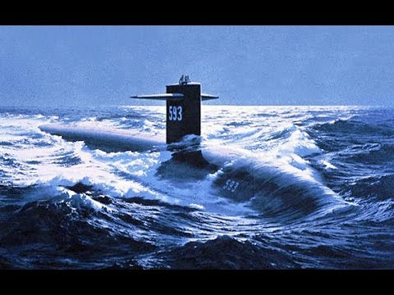
USS Thresher (1963)

Slide 26
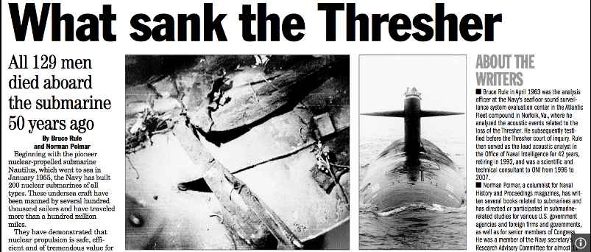

Slide 28
Psalm 110:1
The Lord said to my Lord,
“Sit in the place of honor at my right hand
until I humble your enemies,
making them a footstool under your feet.”

