Slide 2
“Walking in Faith”
1 John

Slide 3
1 John 1:7
…if we walk in the light, as he is in the light, we have fellowship with one another, and the blood of Jesus, his Son, purifies us from all sin.

Slide 4
Agree with God about a beloved son.

Slide 6
1 John 1:1-4 (1st person)
That which was from the beginning, which I have heard, which I have seen with my eyes, which I have looked at and my hands have touched—this I proclaim concerning the Word of life. The life appeared; I have seen it and testify to it, and I proclaim to you the eternal life, which was with the Father and has appeared to me….

Slide 7
…I proclaim to you what I have seen and heard, so that you also may have fellowship with me. And our fellowship is with the Father and with his Son, Jesus Christ. I write this to make our joy complete.

Slide 8
Agree with God about yourself.

Slide 9
The Docetics
Denied the Incarnation
Denied the reality of sin

Slide 10
1 John 1:8
If we claim to be without sin, we deceive ourselves and the truth is not in us.

Slide 11
"Not only do incompetent people reach erroneous conclusions and make unfortunate choices, but their incompetence robs them of the ability to realize it."

Slide 12
“Not only do some sinners reach erroneous conclusions and make unfortunate choices, but their sinfulness robs them of the ability to
see it.”

Slide 13
Agree with God about God.

Slide 14
1 John 1:9-10
If we confess our sins, he is faithful and just and will forgive us our sins and purify us from all unrighteousness. If we claim we have not sinned, we make him out to be a liar and his word is not in us.

Slide 15
confess=con fateri=
“to agree with, declare with”

Slide 16
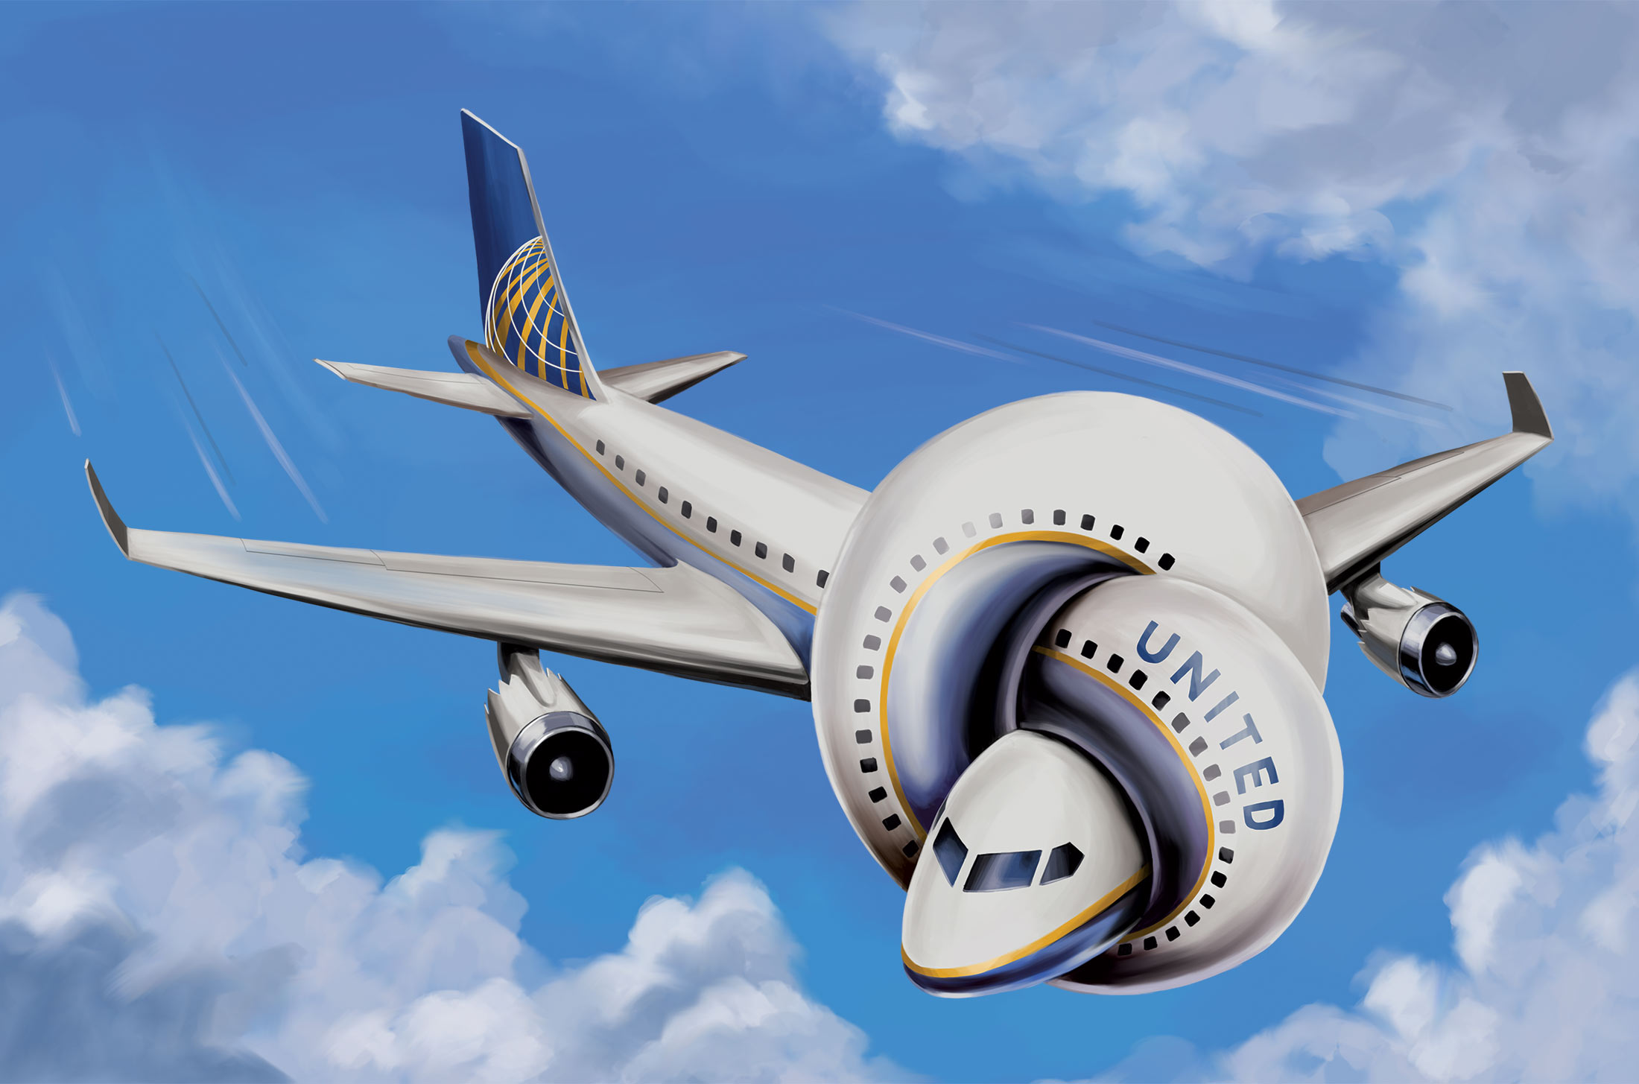

Slide 17
“You carry on, we carry off.”
"Would you like a neck pillow? Or a neck brace?"
"We overbook, but you pay the price!"
"We have Red Eye and Black Eye flights available!"
"We put the hospital in hospitality."
"You can run, but you can't fly."

Slide 18
1 John 1:9
If we confess our sins, he is faithful and just and will forgive us our sins and purify us from all unrighteousness.

Slide 19
1 John 1:10
If we claim we have not sinned, we make him out to be a liar and his word is not in us.

Slide 20
Galatians 6:7
Do not be deceived: God cannot be mocked. A man reaps what he sows.

Slide 21
Agree with God about The Beloved Son.

Slide 22
1 John 2:1-2
My dear children, I write this to you so that you will not sin. But if anybody does sin, we have an advocate with the Father—Jesus Christ, the Righteous One. He is the atoning sacrifice for our sins, and not only for ours but also for the sins of the whole world.

Slide 23
John 14:16
…I will ask the Father, and he will give you another advocate to help you and be with you forever--the Spirit of truth.
allon paraklaton
pros ton

Slide 24
“Stumblers who when they fall stay down are a dime a dozen. In fact, they’re useless. But stumblers who when they fall down get back up—they are as rare as rubies. In fact, they are priceless.” --Chuck Swindoll

