Slide 2
Exodus 20:7
“You must not misuse the name of the Lord your God.”

Slide 3
נָשָׁא = Nasa = “take up, carry”
שָׁוְא = Shav = “without substance” = “mist”

Slide 4
“Cheap grace is the deadly enemy of our Church. We are fighting today for costly grace.”
--Dietrich Bonhoeffer

Slide 5
“Cheap grace means grace sold on the market like cheapjacks’ wares… Forgiveness of sin is thrown away at cut prices…It is grace without price, grace without cost!”

Slide 6
“Cheap grace is the grace we bestow on ourselves. It is the preaching of forgiveness without requiring repentance. Cheap grace is grace without discipleship, grace without the cross, grace without Jesus Christ…

Slide 7
…It is under the influence of cheap grace that the world has been made ‘Christian,’ but at the cost of secularizing the Christian religion as never before.”

Slide 8
2 Corinthians 7:10
For the kind of sorrow God wants us to experience leads us away from sin and results in salvation. There’s no regret for that kind of sorrow. But worldly sorrow, which lacks repentance, results in spiritual death.

Slide 9
“Costly grace is the treasure hidden in the field; for the sake of it a man will gladly go and sell all that he has. It is the pearl of great price to buy which the merchant will sell all his goods. Such grace is costly because it calls us to follow, and it is grace because it calls us to follow Jesus Christ. It is costly because it costs a man his life, and it is grace because it gives a man the only true life…

Slide 10
…It is costly because it condemns sin, and grace because it justifies the sinner. Above all, it is costly because it cost God the life of his Son: ‘ye were bought at a price,’ and what has cost God much cannot be cheap for us. Above all, it is grace because God did not reckon his Son too dear a price to pay for our life, but delivered him up for us.”

Slide 11
GRACE
God’s
Riches
At
Christ’s
Expense

Slide 12
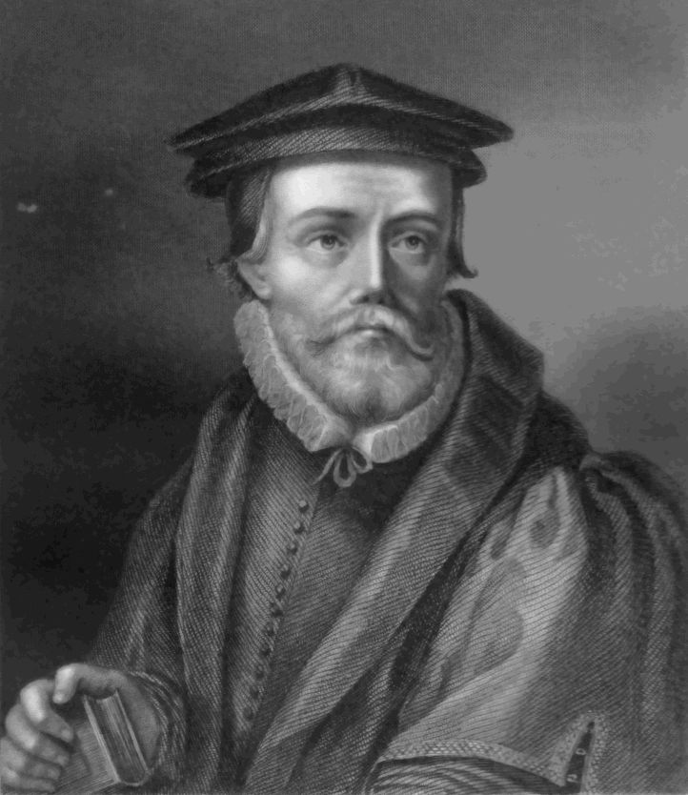

Slide 13
