Slide 3
“The Kingdom of Heaven can be illustrated by the story of a king who prepared a great wedding feast for his son. When the banquet was ready, he sent his servants to notify those who were invited. But they all refused to come!
“So he sent other servants to tell them, ‘The feast has been prepared. The bulls and fattened cattle have been killed, and everything is ready. Come to the banquet!’ But the guests he had invited ignored them and went their own way, one to his farm, another to his business. Others seized his messengers and insulted them and killed them.

Slide 4
We trust that
God will respond righteously.

Slide 5
“But when the king came in to meet the guests, he noticed a man who wasn’t wearing the proper clothes for a wedding. ‘Friend,’ he asked, ‘how is it that you are here without wedding clothes?’ But the man had no reply. Then the king said to his aides, ‘Bind his hands and feet and throw him into the outer darkness, where there will be weeping and gnashing of teeth.’
“For many are called, but few are chosen.”

Slide 6
Matthew 21:45-46
When the leading priests and Pharisees heard this parable, they realized he was telling the story against them—they were the wicked farmers. They wanted to arrest him, but they were afraid of the crowds, who considered Jesus to be a prophet.

Slide 7
2. We Serve…
IMMEDIATELY!

Slide 8
Matthew 22:3
When the banquet was ready, he sent his servants to notify those who were invited.

Slide 9
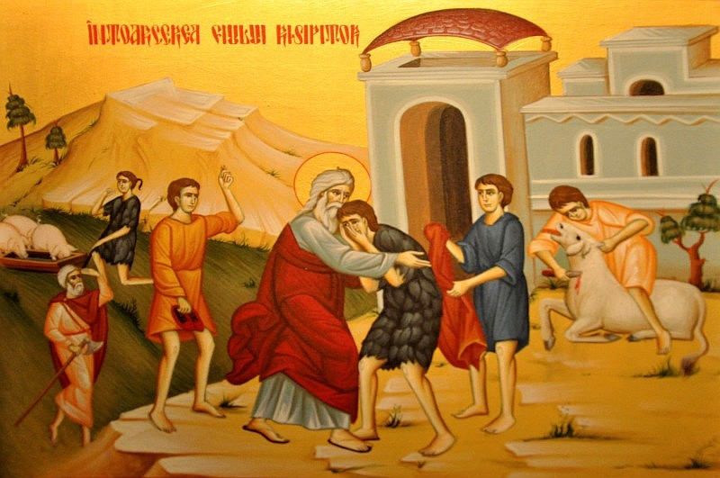

Slide 10
2. We Serve…
INCLUSIVELY!

Slide 11
Matthew 22:9-10
Now go out to the street corners and invite everyone you see.’ So the servants brought in everyone they could find, good and bad alike…

Slide 13
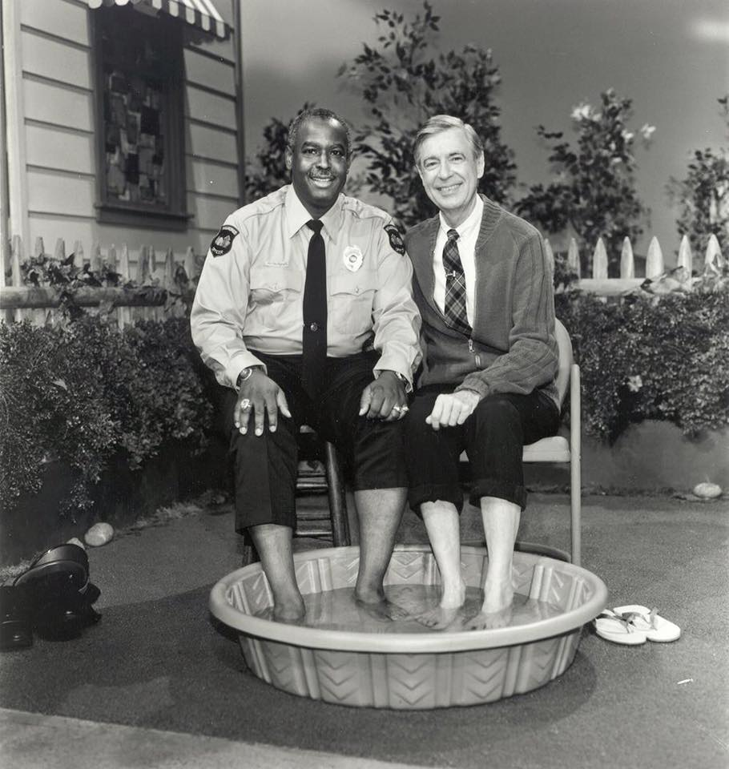

Slide 14
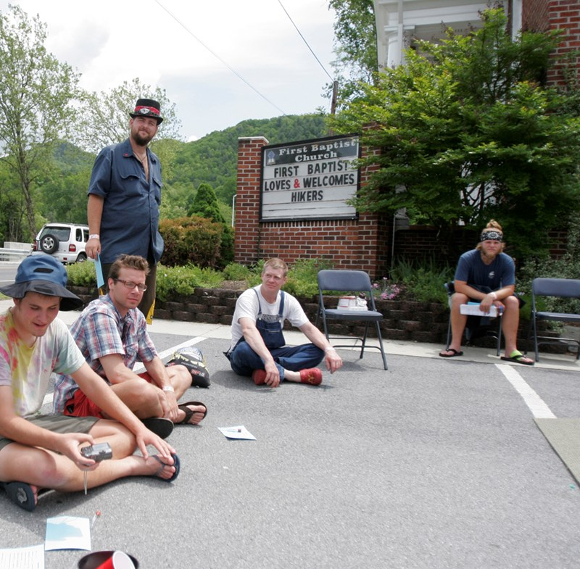

Slide 16
3. We celebrate that
the banquet is filled with
decked-out partiers!

Slide 17
Matthew 22:10
So the servants brought in everyone they could find, good and bad alike, and the banquet hall was filled with guests.

Slide 18
Isaiah 61:10 (NRSV)
I will greatly rejoice in the Lord,
my whole being shall exult in my God;
for he has clothed me with the garments of salvation,
he has covered me with the robe of righteousness,
as a bridegroom decks himself with a garland,
and as a bride adorns herself with her jewels!

