Slide 2
CNNECT

Slide 3
CONNECT Where You Are
CONNECT Where You Live
CONNECT Where You Go
CONNECT When You Pray
CONNECT Where You Work

Slide 4
1. Connecting with the Gospel began on a work day!

Slide 5
2. Jesus connected
during the work day!

Slide 6
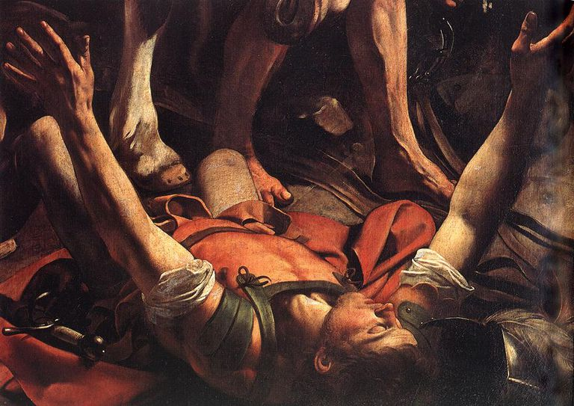

Slide 8
3. Paul’s way of connecting at work:
A. Seek Out

Slide 9
Verse 2
Devote yourselves to prayer with an alert mind and a thankful heart.

Slide 10
Colossians 3:23-24
Work willingly at whatever you do, as though you were working for the Lord rather than for people. Remember that the Lord will give you an inheritance as your reward, and that the Master you are serving is Christ.

Slide 11
3. Paul’s way of connecting at work:
A. Seek Out
B. Speak Out

Slide 12
Center for Faith and Work
survey of working believers:
Only 6% had shared their faith
at work
Only 55% had prayed about
their work

Slide 13
Verses 3-4
Pray for us, too, that God will give us many opportunities to speak about his mysterious plan concerning Christ. That is why I am here in chains. Pray that I will proclaim this message as clearly as I should.

Slide 14
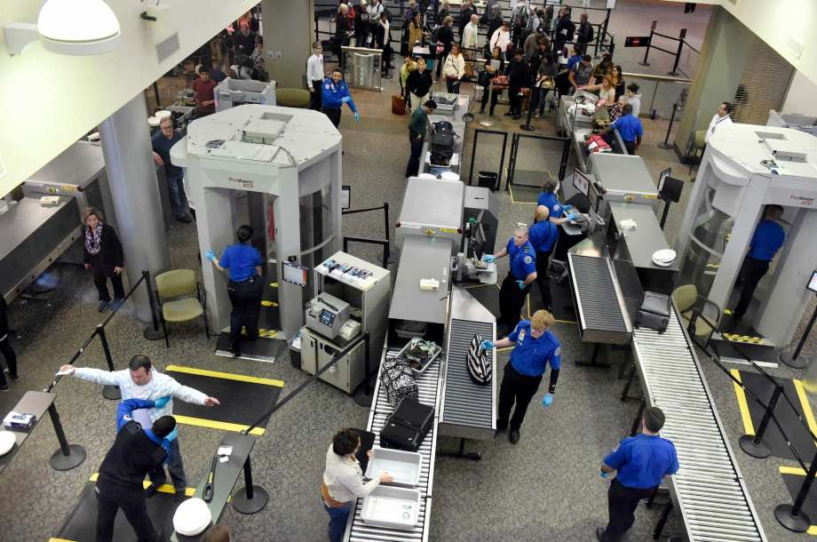

Slide 15
3. Paul’s way of connecting at work:
A. Seek Out
B. Speak Out
C. Stand Out

Slide 16
Verses 5-6
Live wisely among those who are not believers, and make the most of every opportunity. Let your conversation be gracious and attractive so that you will have the right response for everyone.

Slide 17


