Slide 2
The so-called “circular letter” that stresses the unity of the body of Christ is
_____“O”______.

Slide 3


Slide 5
“Mission is the meaning of the church. Indeed, the church is mission, and where there is no mission there is no church. God has called the church out from the world to send her back into the world with a message and a mission.”
--Dale Moody, The Word of Truth

Slide 6
Ephesians 3:20-21
Now all glory to God, who is able, through his mighty power at work within us, to accomplish infinitely more than we might ask or think. Glory to him in the church and in Christ Jesus through all generations forever and ever! Amen.

Slide 7
“infinitely more”
“Infinitely” = huperpanta = “beyond and above all”
“More” = huperekperissou
huper=”above” ek=”out of, beyond” perissou—“around”

Slide 8


Slide 9
Ephesians 3:20-21
Now all glory to God, who is able, through his mighty power at work within us, to accomplish infinitely more than we might ask or think. Glory to him in the church and in Christ Jesus through all generations forever and ever! Amen.

Slide 11
Ephesians 4:1-3
Therefore I, a prisoner for serving the Lord, beg you to lead a life worthy of your calling, for you have been called by God. Always be humble and gentle. Be patient with each other, making allowance for each other’s faults because of your love. Make every effort to keep yourselves united in the Spirit, binding yourselves together with peace.

Slide 12
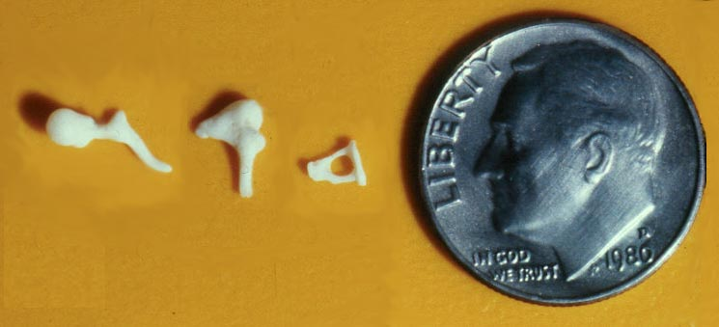

Slide 14
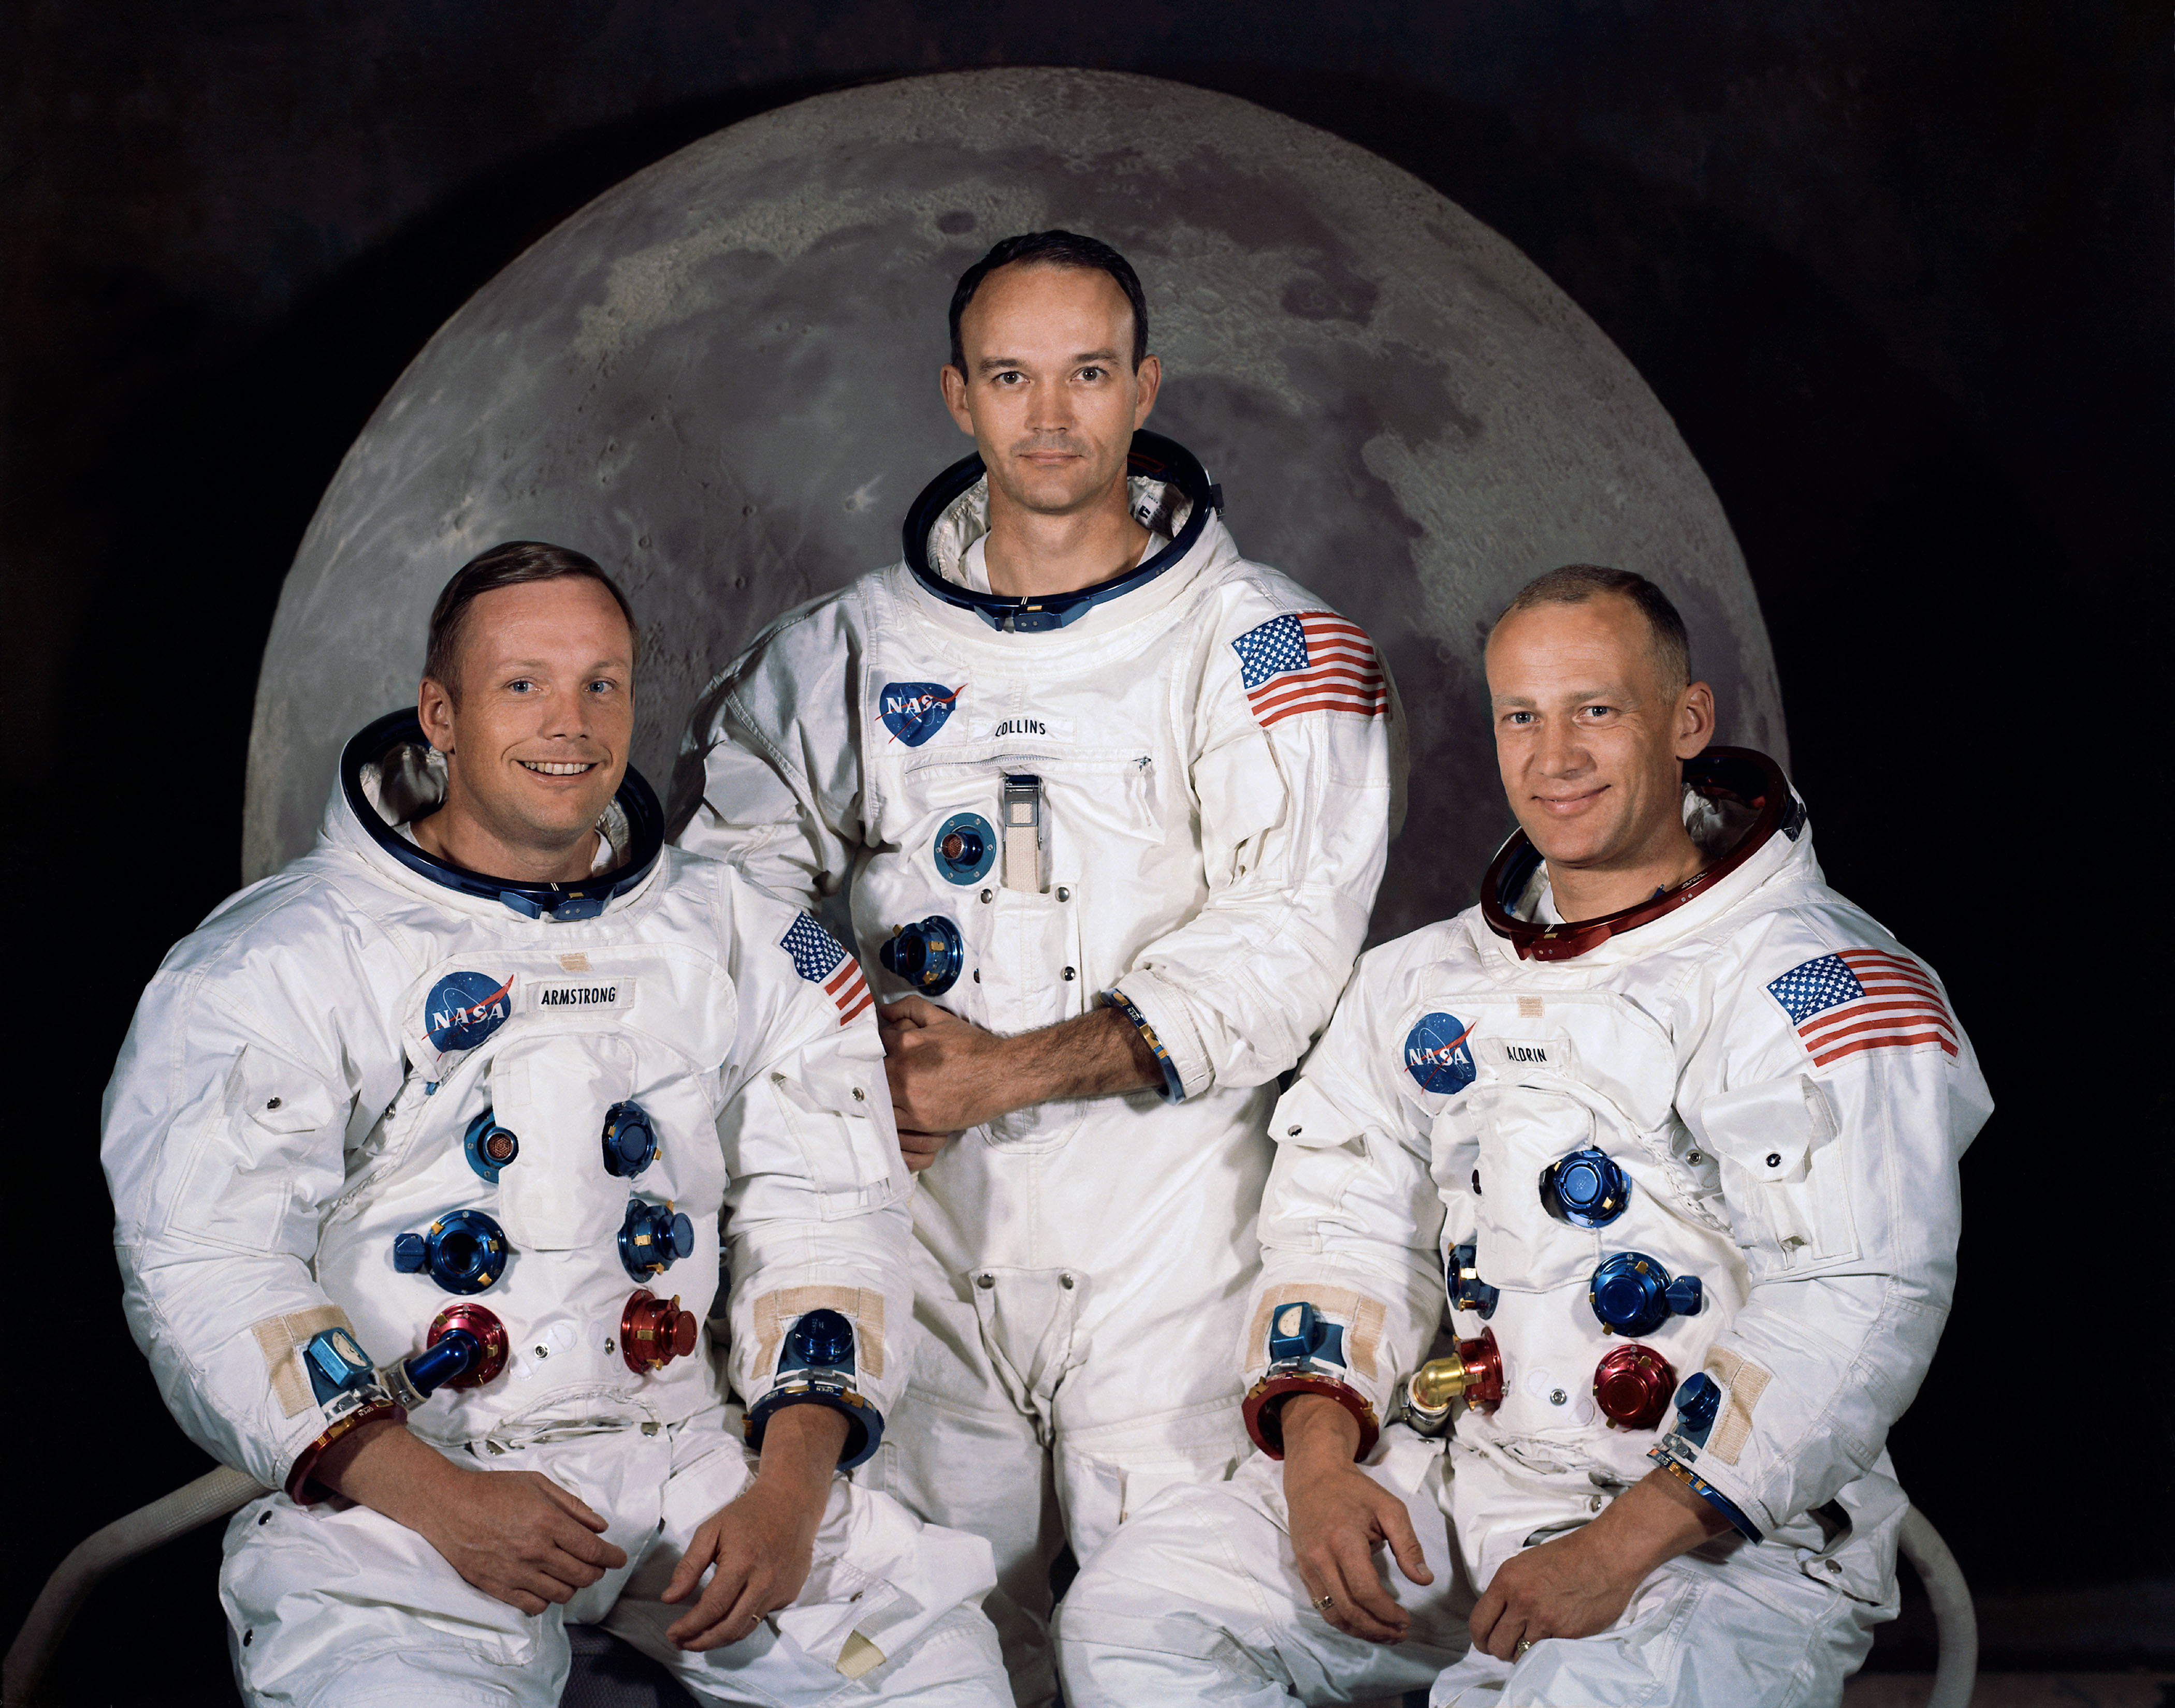

Slide 15


Slide 16
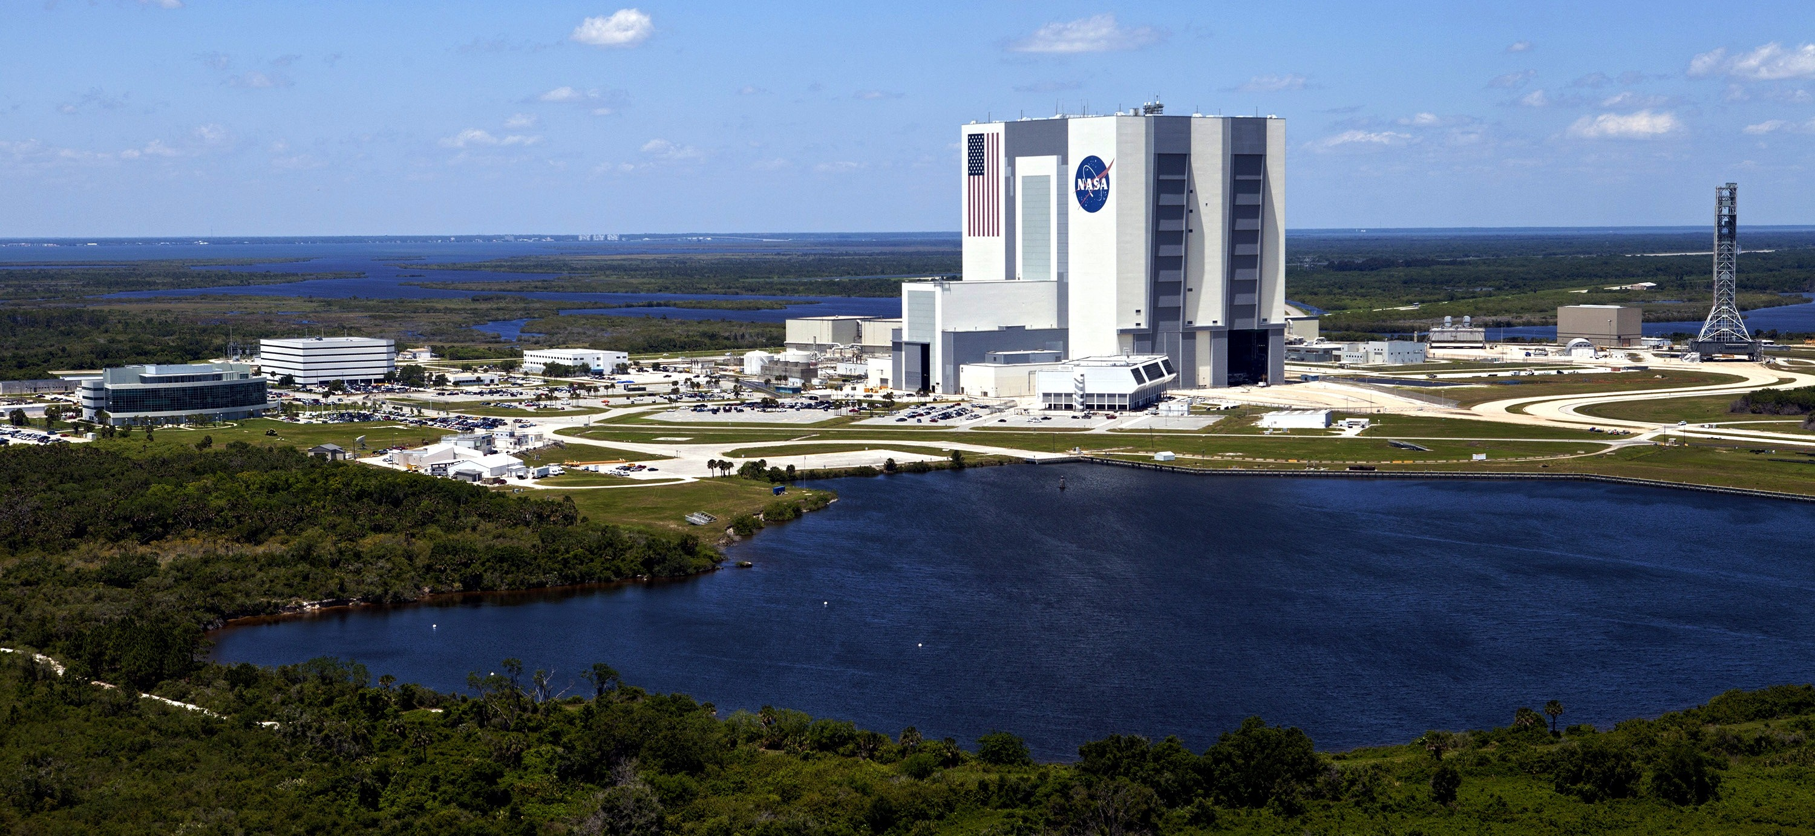

Slide 17
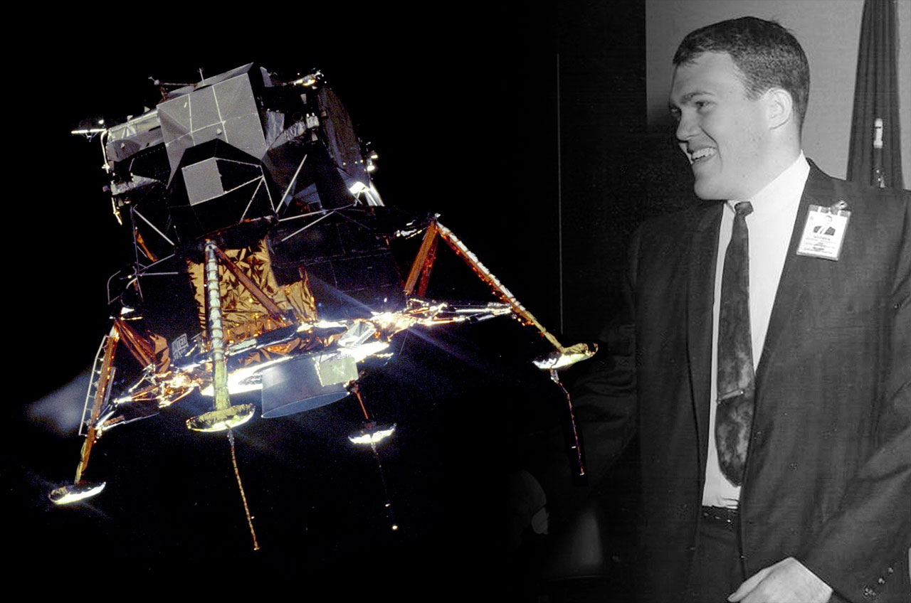

Slide 18
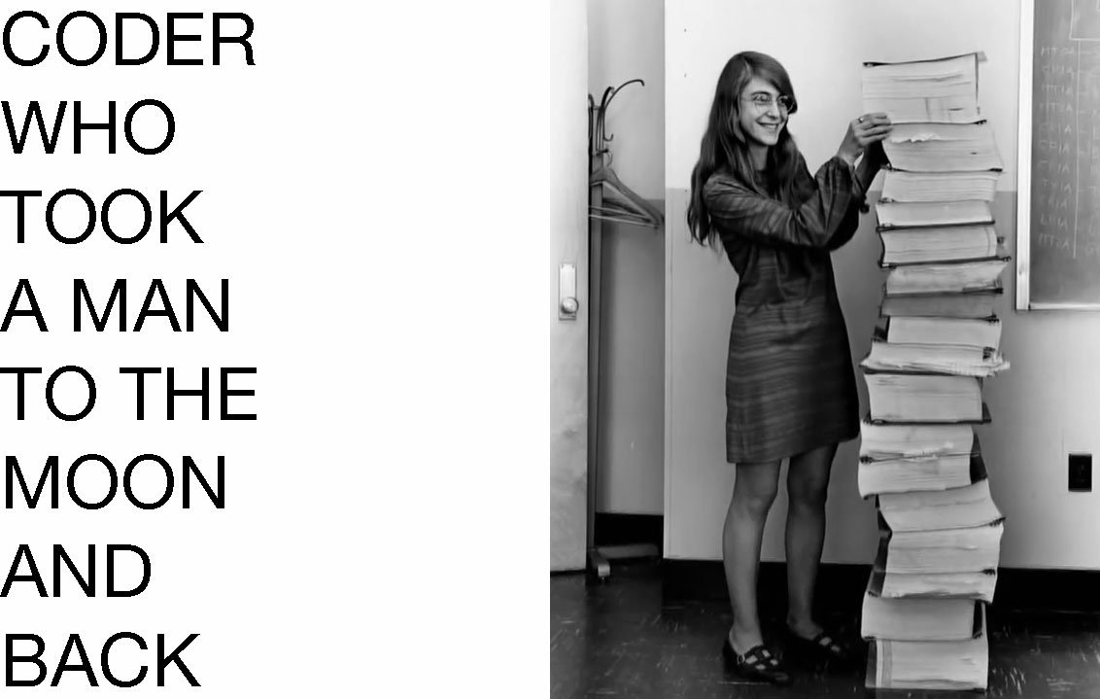

Slide 19
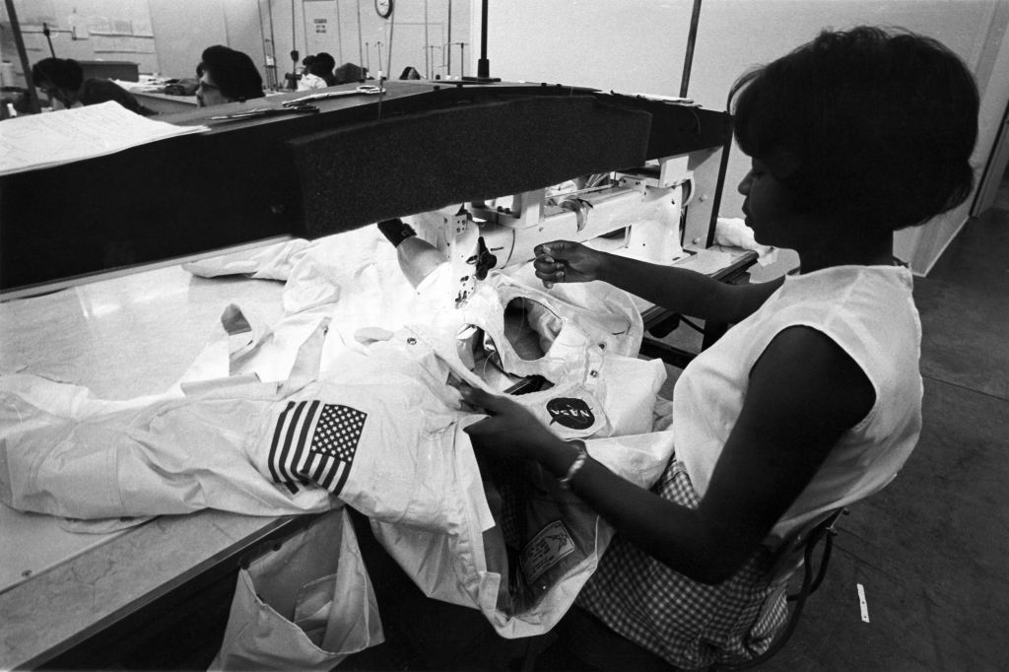

Slide 20
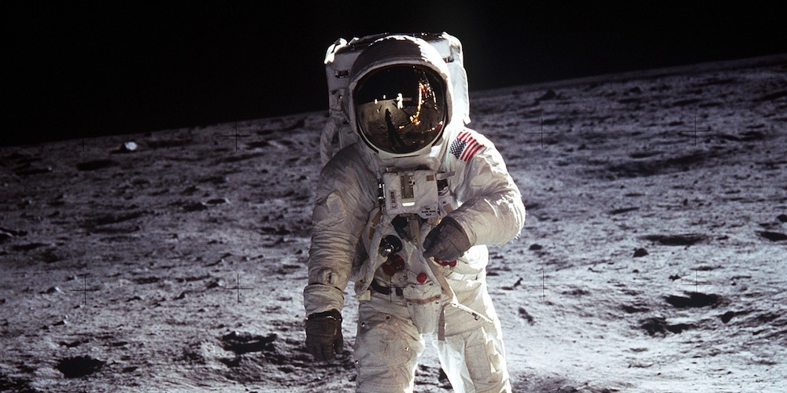

Slide 21
Ephesians 3:20-21
Now all glory to God, who is able, through his mighty power at work within us, to accomplish infinitely more than we might ask or think. Glory to him in the church and in Christ Jesus through all generations forever and ever! Amen.

