Slide 2
Extravagant
for
Our Extravagant God

Slide 3
Extravagant giving to Our God is BEAUTIFUL!

Slide 4
Verse 6 (NIV)
“Leave her alone,” said Jesus. “Why are you bothering her? She has done a beautiful thing to me.”

Slide 6
Extravagant giving to Our God is
TIMELY!

Slide 7
Verses 7-8
“You will always have the poor among you, and you can help them whenever you want to. But you will not always have me. She has done what she could and has anointed my body for burial ahead of time.”

Slide 8
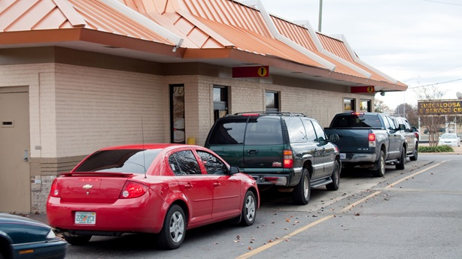

Slide 12
Extravagant giving to Our God is
MEMORABLE!

Slide 13
Verse 9
“I tell you the truth, wherever the Good News is preached throughout the world, this woman’s deed will be remembered and discussed.”

Slide 15
Luke 18:28-30
Peter said, “We’ve left our homes to follow you.”
“Yes,” Jesus replied, “and I assure you that everyone who has given up house or wife or brothers or parents or children, for the sake of the Kingdom of God, will be repaid many times over in this life, and will have eternal life in the world to come.”

Slide 16
“I'm convinced that heaven's unnecessariness is what makes it important…Heaven is simply a glorious, gratuitous extra, totally unnecessary, but totally in character with the extravagant goodness and boundless creativeness of the Maker and Redeemer of this world.”
-- John Leax

