Slide 2
Psalm 147:11
יְהֹוָה Yĕhovah The LORD
רָצָה ratsah delights in
יָרֵא yare' those who fear Him
יָחַל yachal In those who hope/expect/wait
חֶסֶד checed for His lovingkindness/mercy

Slide 3
“Expect great things from God; attempt great things for God.” William Carey
My expectation of God’s greatness better precede and exceed my perspiration for God’s greatness!

Slide 4
The Lord delights in those who fear him, who put their hope in his unfailing love. NIV/NLT
But the Lord takes pleasure in those who fear him, in those who hope in his steadfast love. ESV
The Lord taketh pleasure in them that fear him, in those that hope in his mercy. KJV
Those who fear God get God’s attention; they can depend on his strength. MESSAGE

Slide 5
But his joy is in those who reverence him, those who expect him to be loving and kind.
Living Bible
Jehovah is pleased with those fearing Him, With those waiting for His kindness.
Young’s Literal Translation
But the Eternal does take pleasure in those who worship Him, those who invest hope in His unfailing love. The VOICE

Slide 6
God’s Delight
רָצָהratsah favors
To be pleased with, specifically, to satisfy a debt. To delight in. Same word that’s used over and over in the book of Leviticus to mean the acceptance of an offering.
And he shall put his hand upon the head of the burnt offering; and it shall be accepted for him to make atonement for him. Leviticus 1:4

Slide 7
No assumptions in worship: A Warning from Isaiah 1
¹¹ “The multitude of your sacrifices— what are they to me?” says the Lord. “I have more than enough of burnt offerings, of rams and the fat of fattened animals; I have no pleasure in the blood of bulls and lambs and goats. ¹² When you come to appear before me, who has asked this of you, this trampling of my courts?

Slide 8
¹³ Stop bringing meaningless offerings! Your incense is detestable to me. New Moons, Sabbaths and convocations— I cannot bear your worthless assemblies. ¹⁴ Your New Moon feasts and your appointed festivals I hate with all my being. They have become a burden to me; I am weary of bearing them.

Slide 9
¹⁵ When you spread out your hands in prayer, I hide my eyes from you; even when you offer many prayers, I am not listening.
Your hands are full of blood!
¹⁶ Wash and make yourselves clean. Take your evil deeds out of my sight; stop doing wrong. ¹⁷ Learn to do right; seek justice. Defend the oppressed.

Slide 10
Yare…to fear or revere?
Deliver me, I pray thee, from the hand of my brother, from the hand of Esau: for I fear him, lest he will come and smite me, and the mother with the children. Gen. 32:11

Slide 11
The great temptations which thine eyes saw, and the signs, and the wonders, and the mighty hand, and the stretched out arm, whereby the LORD thy God brought thee out: so shall the LORD thy God do unto all the people of whom thou art afraid. Deut. 7:19

Slide 12
Fearing the Lord’s Wisdom
“Trust in the Lord with all your heart, and lean not on your own understanding; in all your ways acknowledge him and he will direct your paths.” Prov. 3:5-6
If we do lean on our own understanding, then:
We are not trusting in the Lord with all our heart
We are not acknowledging him in all our ways
He will not direct our paths

Slide 13
Fearing the Lord’s Justice
God is just. He loves truth. He loves honest scales. Much of the story of God found both in Scripture and throughout history attests to God’s love of justice.
And so another way that I fear the Lord is that I fear God’s justice.
He will judge: Oppression of the poor, domination of the weak, exploitation of the innocent. Manipulating those mentally challenged.

Slide 14
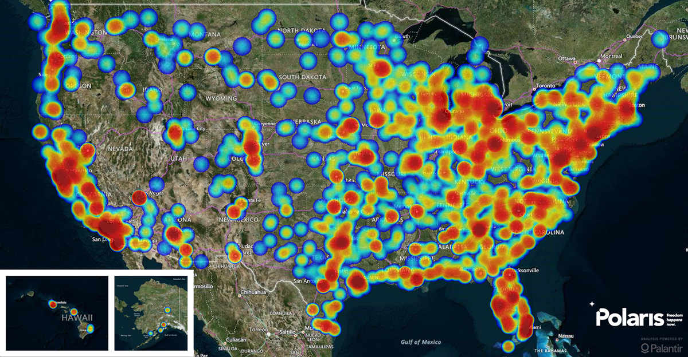
Human Trafficking Map 2017

Slide 15
And without faith it is impossible to please God, because anyone who comes to him must believe that he exists and that he rewards those who earnestly seek him.
Hebrews 11:6

Slide 16
Fear Rewarded in the Psalms
When we fear God, he :
Honors us, is glorified, teaches us his way, is a friend to those who fear him, teaches them his covenant, laid up goodness for them, his eyes are on them, angel camps around them, delivers them, provides all they need, gives them banner of truth, inheritance reserved, salvation near,

Slide 17
Fear Rewarded in the Psalms
Great is his mercy toward them, from everlasting to everlasting his righteousness is on their children’s children, he will ever be mindful of his covenant/promises, he is their help and shield, they will be glad when they see God, blessed is every one who fears God, he will fulfill their desires, hear their cry and save them

Slide 18
To have a healthy fear of the Lord is to:
place your hope in his unfailing love.
wait on his unfailing love
expect the goodness that is inseparable from his unfailing love

Slide 19
“Expect great things from God; attempt great things for God.” William Carey
My expectation of God’s greatness better precede and exceed my perspiration for God’s greatness!

Slide 20
2019 40 Day Prayer Challenge!
January 1 – February 9
CONNECT Theme
Prayer Guides will be distributed in December.

