Slide 2
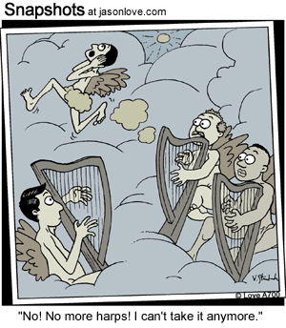

Slide 3
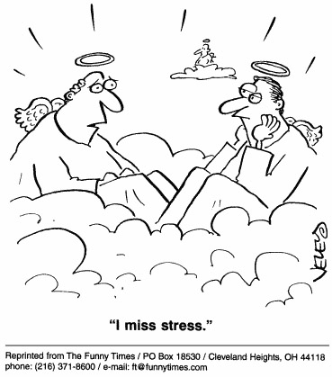

Slide 4
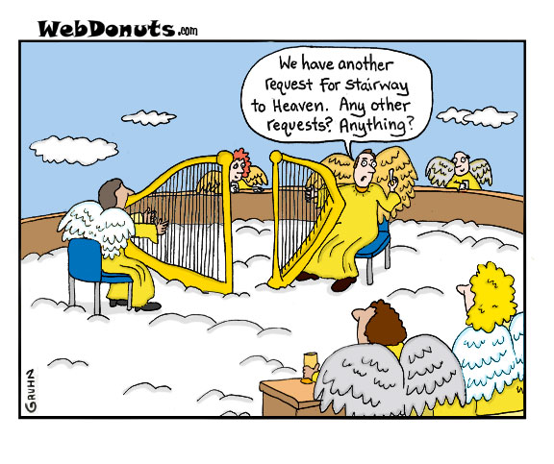

Slide 6
Heaven is…
Familiar

Slide 7
John 14:2-3
There is more than enough room in my Father’s home. If this were not so, would I have told you that I am going to prepare a place for you? When everything is ready, I will come and get you, so that you will always be with me where I am. And you know the way to where I am going.”

Slide 8
Luke 23:42-43
Then he said, “Jesus, remember me when you come into your Kingdom.” And Jesus replied, “I assure you, today you will be with me in paradise.”

Slide 10
Heaven is…
Together

Slide 11
Hebrews 4:9-11
So there is a special rest still waiting for the people of God. For all who have entered into God’s rest have rested from their labors, just as God did after creating the world. So let us do our best to enter that rest.

Slide 12
Hebrews 11:14-16
God’s people…are looking forward to a country they can call their own. If they had longed for the country they came from, they could have gone back. But they were looking for a better place, a heavenly homeland. That is why God is not ashamed to be called their God, for he has prepared a city for them.

Slide 13
This is my Father’s world:
Oh, let me ne’er forget
That though the wrong seems oft so strong,
God is the ruler yet.
This is my Father’s world,The battle is not done:
Jesus who died shall be satisfied,
And earth and Heav’n __ ___.

Slide 14
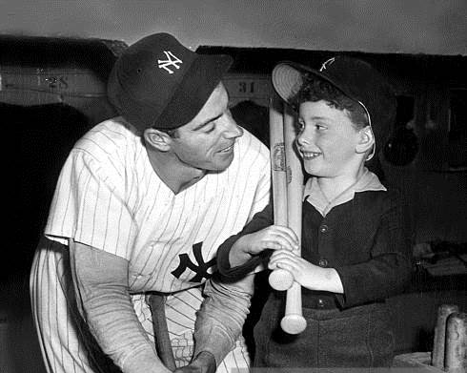

Slide 15
Heaven is…
Secure

Slide 16
Revelation 21:3-4
I heard a loud shout from the throne, saying, “Look, God’s home is now among his people! He will live with them, and they will be his people. God himself will be with them. He will wipe every tear from their eyes, and there will be no more death or sorrow or crying or pain. All these things are gone forever.”

Slide 17
1 Peter 1:3-4
All praise to God, the Father of our Lord Jesus Christ. It is by his great mercy that we have been born again, because God raised Jesus Christ from the dead. Now we live with great expectation, and we have a priceless inheritance—an inheritance that is kept in heaven for you, pure and undefiled, beyond the reach of change and decay.

Slide 18
1 Corinthians 15:54-57
Then, when our dying bodies have been transformed into bodies that will never die, this Scripture will be fulfilled:
“Death is swallowed up in victory.
O death, where is your victory?
O death, where is your sting?”
For sin is the sting that results in death, and the law gives sin its power. But thank God! He gives us victory over sin and death through our Lord Jesus Christ.

Slide 19
“Think of a great moment in life when you really enjoyed the thrill of living. Then go back and think of some great moment when somebody told you the truth or you made a study of a great mystery and finally understood it. Then go to another moment of your life when you had a great ecstasy of love and you wanted it to go on and on and on…

Slide 20
…Now suppose you could take this moment of life, raise it up to a focal point where it became the far deepest truth, lift it to infinity until it became the moment of the ecstasy of truth, and take that moment of love and eternalize it forever. Well, that gives some dim suggestion of what heaven is. It is perfect life. It is perfect truth. It is perfect love.”
--Fulton Sheen

Slide 21
1 Corinthians 2:9
“No eye has seen,
no ear has heard,
and no mind has imagined
what God has prepared
for those who love him.”

Slide 22
When we’ve been there ten thousand years,
Bright shining as the sun,
We’ve no less days to sing God’s praise
Than when we’d first begun.

Slide 23
…God our Savior, who wants everyone to be saved and to understand the truth. – 1 Timothy 4:2
He does not want anyone to be destroyed, but wants everyone to repent. – 2 Peter 3:9

Slide 24
“Prepare your heart for your departure. If you are wise, you will expect it every hour.”
--St. Isaac the Syrian
7th Century Christian mystic

