Slide 2
Holmes Rahe Scale
• Marital separation 65
• Marriage 50
• Marital reconciliation 45
• Pregnancy 40
• Adding a new family member 39
• Change in financial state 38
• Trouble with in-laws 29
• Change in living conditions 25
• Change in working conditions 20
• Change in residence 20
• Change in church activities 19
• Change in social activities 18
• Change in sleep habits 16
• Minor violation of the law 11
• Christmas(!) 12

Slide 4
Luke 9:51 (NRSV)
When the days drew near for him to be taken up, he set his face to go to Jerusalem.

Slide 6
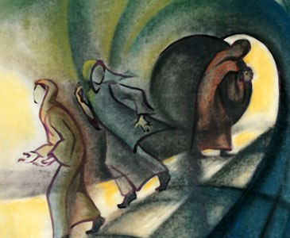

Slide 8
Despite our efforts to keep him out, God intrudes. The life of Jesus is bracketed by two impossibilities: a virgin's womb and an empty tomb. Jesus entered our world through a door marked "No Entrance" and left through a door marked "No Exit."
-- Peter Larson

