Slide 2
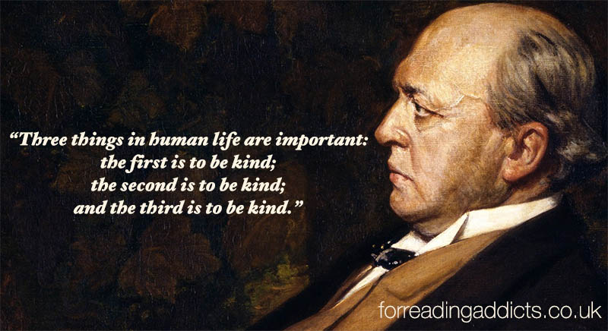

Slide 3
Ephesians 4:32
Be kind to each other, tenderhearted, forgiving one another, just as God through Christ has forgiven you.

Slide 4
The Motive of Kindness

Slide 5
A. Selfless

Slide 6
*The Message
Love is patient = “Love never gives up.”
Love is kind = “Love cares more for others than for self.”

Slide 7
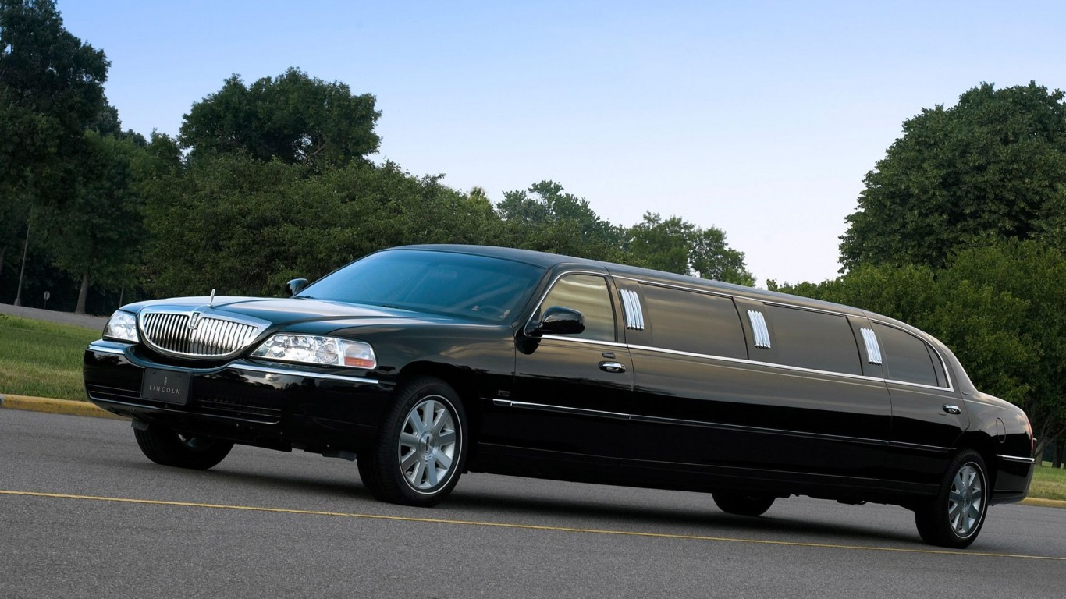

Slide 9
B. Small

Slide 10
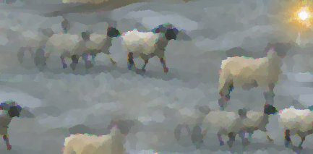
Matthew 25
The Small Kindness of the Sheep

Slide 11
Pledge Sunday
Next Week

Slide 12
The Joy of Kindness

Slide 13
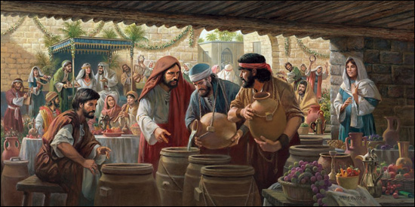

Slide 15
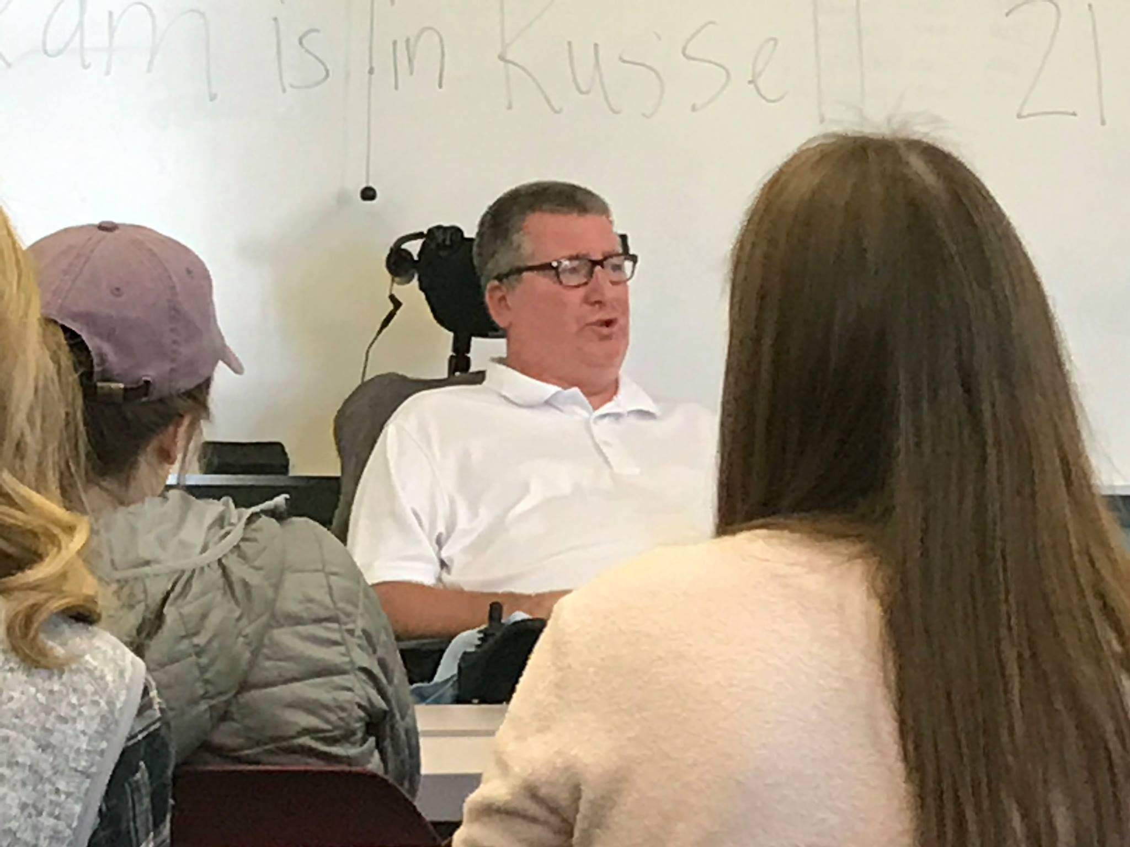
"Not that I’m looking for handouts, but I do want you to experience the blessing that issues from generosity." (MSG)
“Not that I’m looking for handouts, but I do want you to experience the blessing that issues from generosity.” Philippians 4:17 (MSG)

Slide 16
The Difference Kindness Makes

Slide 17
Ephesians 2:4-7
But God is so rich in mercy, and he loved us so much, that even though we were dead because of our sins, he gave us life when he raised Christ from the dead. (It is only by God’s grace that you have been saved!) For he raised us from the dead along with Christ and seated us with him in the heavenly realms because we are united with Christ Jesus. So God can point to us in all future ages as examples of the incredible wealth of his grace and kindness toward us, as shown in all he has done for us who are united with Christ Jesus.

Slide 18
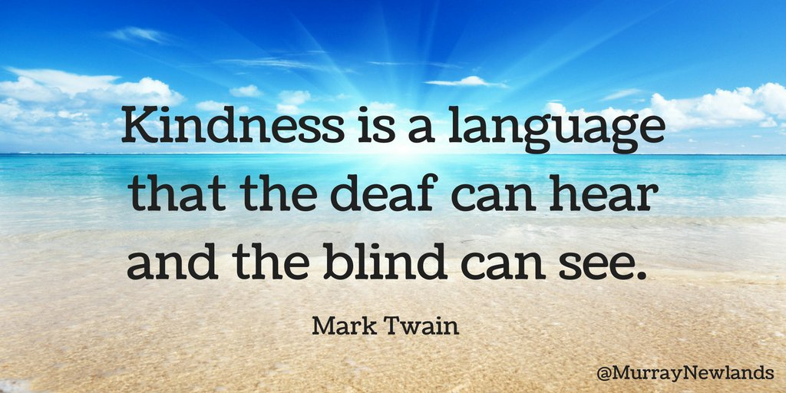

Slide 20
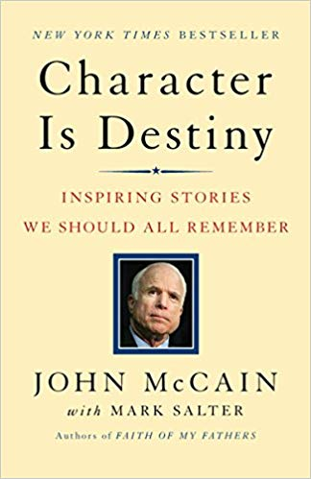

Slide 21
“For just that moment I forgot all my hatred for my enemies, and all the hatred most of them felt for me. I forgot about the jerk and the interrogators who persecuted my friends and me. I forgot about the war and the terrible things that war does to you. I was just one Christian venerating the cross with a fellow Christian on Christmas morning.”
“I saw him again occasionally. But he never looked at me or attempted to speak to me. We never worshiped together again…

Slide 22
But I have never forgotten him or the kindness he showed me as a testament to the faith we shared. That experience helped to form my lasting appreciation for my own religious faith, and it took the faith of an enemy to reveal it to me, the faith that unites and never divides, the faith that bridges unbridgeable divisions in humanity, the faith that we are all, sinners and saints alike, children of God. I became a better man, a stronger man, a more faithful man, who, for at least a moment, could love his enemies.”

Slide 23
Ephesians 1:7
He is so rich in kindness and grace that he purchased our freedom with the blood of his Son and forgave our sins.

Slide 24
Titus 3:3-5
Once we, too, were foolish and disobedient. We were misled and became slaves to many lusts and pleasures. Our lives were full of evil and envy, and we hated each other. But—
When God our Savior revealed his kindness and love, he saved us, not because of the righteous things we had done, but because of his mercy. He washed away our sins, giving us a new birth and new life through the Holy Spirit.

