Slide 2
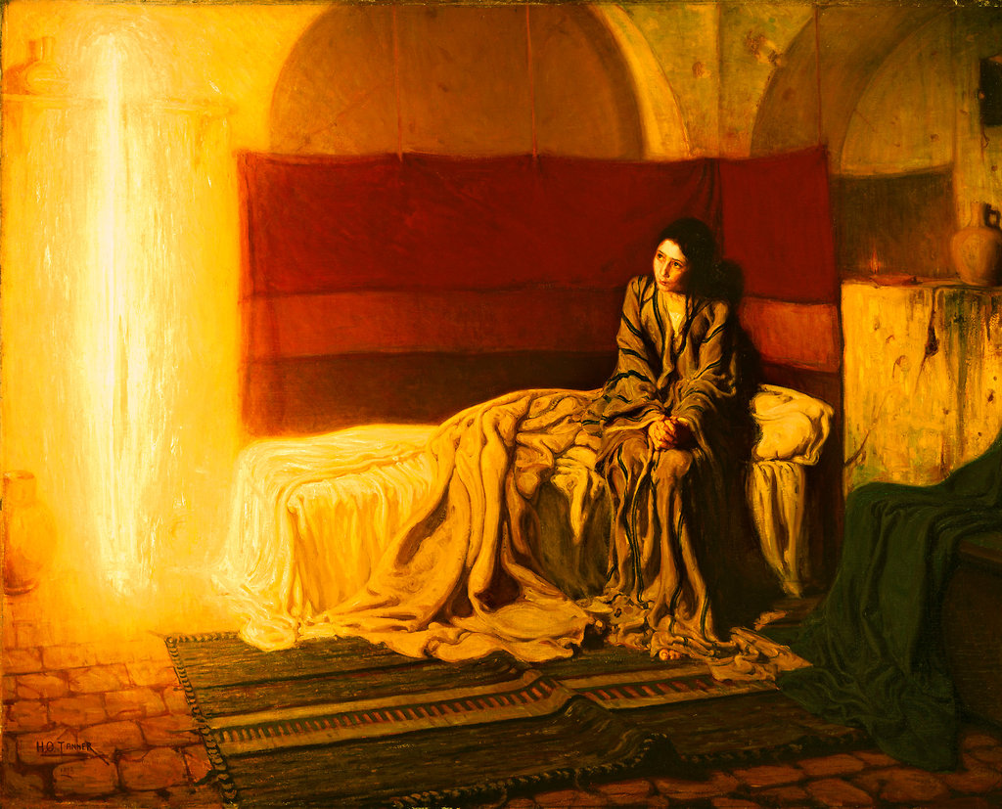

Slide 3
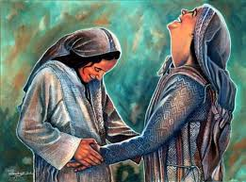

Slide 4
Verses 36-37
“…your relative Elizabeth has become pregnant in her old age! People used to say she was barren, but she has conceived a son and is now in her sixth month. For the word of God will never fail.”

Slide 5
Through Mary and Elizabeth, we witness the glorious revolution of Advent in…
The Visitation

Slide 6
Verses 41-42
At the sound of Mary’s greeting, Elizabeth’s child leaped within her, and Elizabeth was filled with the Holy Spirit. Elizabeth gave a glad cry and exclaimed to Mary, “God has blessed you above all women, and your child is blessed!

Slide 7
Verses 43,45
“Why am I so honored, that the mother of my Lord should visit me?
…You are blessed because you believed that the Lord would do what he said.”

Slide 8
Romans 10:9
If you openly declare that Jesus is Lord and believe in your heart that God raised him from the dead, you will be saved.

Slide 9
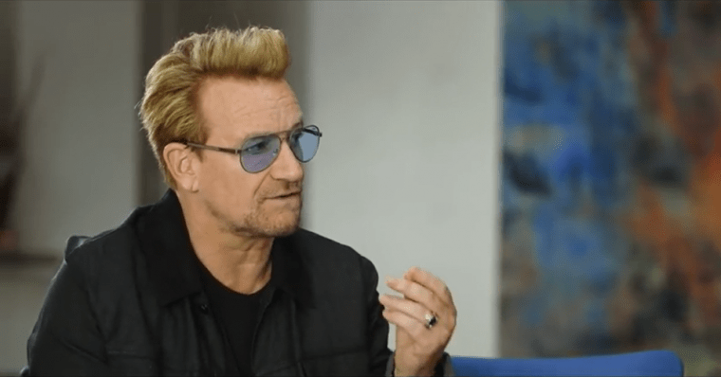

Slide 10
Through Mary and Elizabeth, we witness the glorious revolution of Advent in….
The Magnificat

Slide 11
“Oh, how my soul praises the Lord.
How my spirit rejoices in God my Savior!
For he took notice of his lowly servant girl,
and from now on all generations will call me
blessed.
For the Mighty One is holy,
and he has done great things for me.
He shows mercy from generation to generation
to all who fear him…”

Slide 12
Mary’s Magnificat
Genesis
Exodus
Deuteronomy
1 & 2 Samuel
Job
Psalms
Isaiah
Ezekiel
Habakkuk
Micah
Zephaniah

Slide 13
His mighty arm has done tremendous things!
He has scattered the proud and haughty ones.
He has brought down princes from their thrones
and exalted the humble.
He has filled the hungry with good things
and sent the rich away with empty hands.
He has helped his servant Israel
and remembered to be merciful.
For he made this promise to our ancestors,
to Abraham and his children forever.”

Slide 14
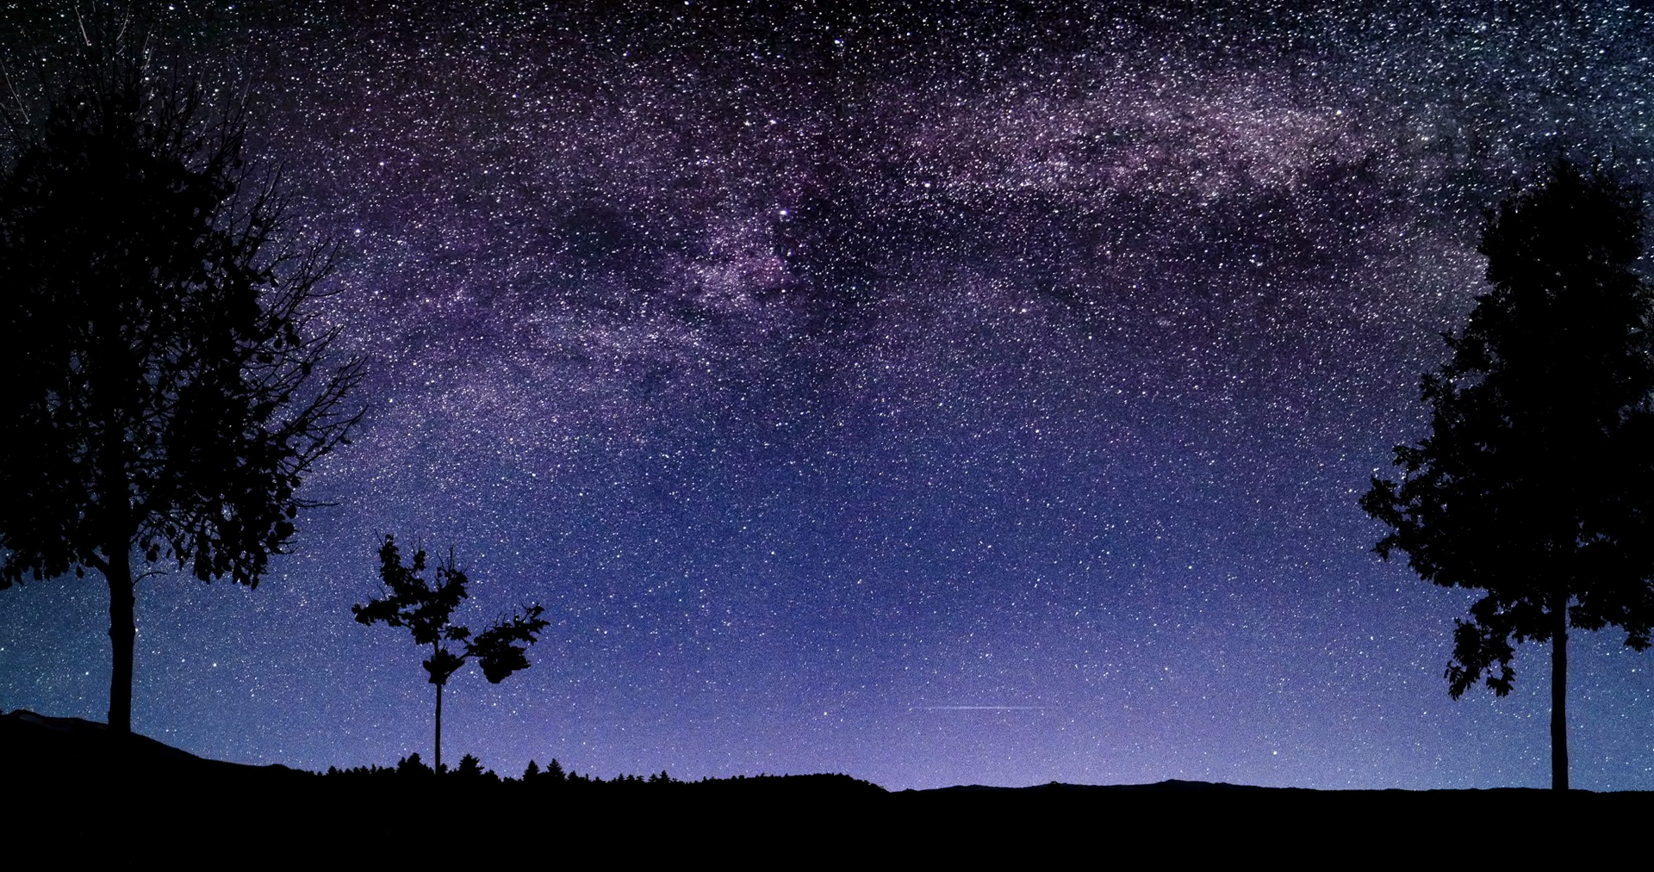

Slide 15
Through Mary and Elizabeth, we witness the glorious revolution of Advent in…
The Blessing

Slide 16
Verses 42,45
Elizabeth gave a glad cry and exclaimed to Mary, “God has blessed you above all women, and your child is blessed…
You are blessed because you believed that the Lord would do what he said.”

Slide 17
Verse 48
“…from now on all generations will call me blessed.”

Slide 18
