Slide 2
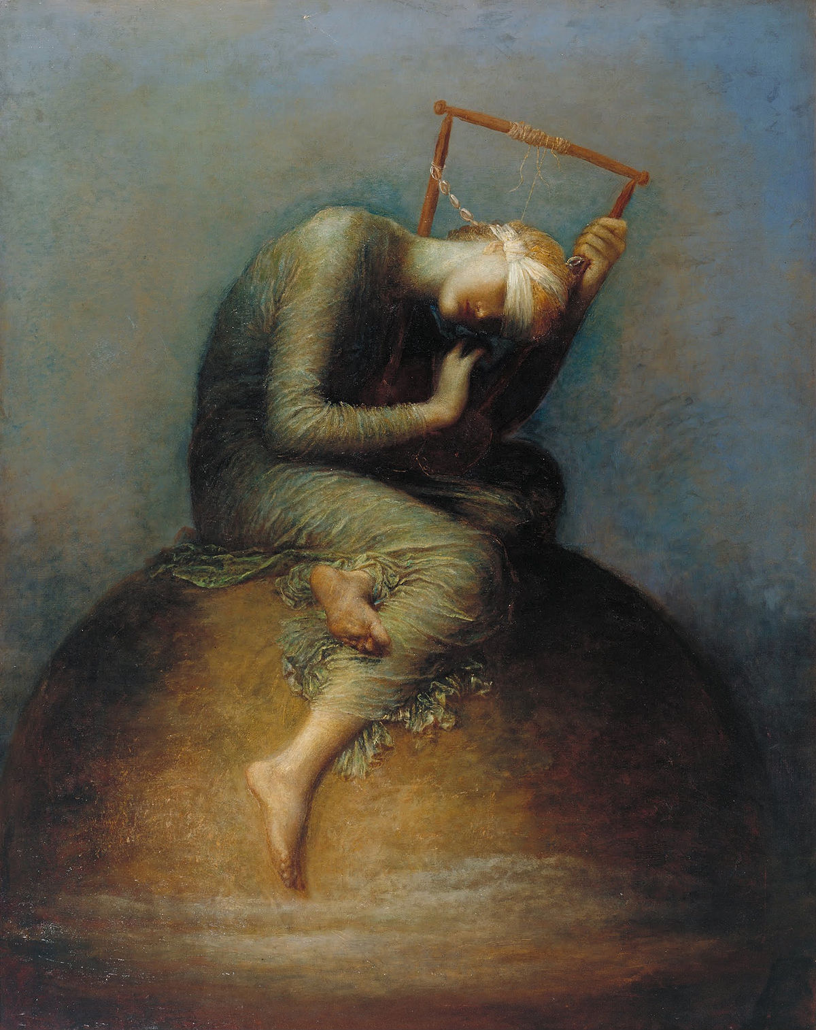

Slide 4
Romans 5:1
Therefore, since we have been made right in God’s sight by faith, we have peace with God because of what Jesus Christ our Lord has done for us.

Slide 5
1. Grasp that we have peace with God.

Slide 6
Rom. 5:1 (NIV) -- Therefore, since we have been justified through faith, we have peace with God through our Lord Jesus Christ…
Rom. 5:11 -- …we also boast in God through our Lord Jesus Christ, through whom we have now received reconciliation.
Rom. 5:21 -- now God’s wonderful grace rules instead, giving us right standing with God and resulting in eternal life through Jesus Christ our Lord.

Slide 7
Rom. 6:23 -- For the wages of sin is death, but the free gift of God is eternal life through Christ Jesus our Lord.
Romans 7:25 -- Thanks be to God, who delivers me through Jesus Christ our Lord!

Slide 8
2. Grasp that we have direct access to God.

Slide 9
Romans 5:2
Because of our faith, Christ has brought us into this place of undeserved privilege where we now stand, and we confidently and joyfully look forward to sharing God’s glory.

Slide 10
3. Grasp that we rejoice in the hope of the glory of God.

Slide 11
Romans 5:2
Because of our faith, Christ has brought us into this place of undeserved privilege where we now stand, and we confidently and joyfully look forward to sharing God’s glory.

Slide 13
Romans 8:18-21
Yet what we suffer now is nothing compared to the glory he will reveal to us later. For all creation is waiting eagerly for that future day when God will reveal who his children really are…the creation looks forward to the day when it will join God’s children in glorious freedom from death and decay.

