Slide 2
Raw Prayers:
Psalms That
Move Us
from Hurt to Hope

Slide 3
Praying Our Loneliness
Psalm 142

Slide 4
Praying our way
out of the cave…

Slide 5
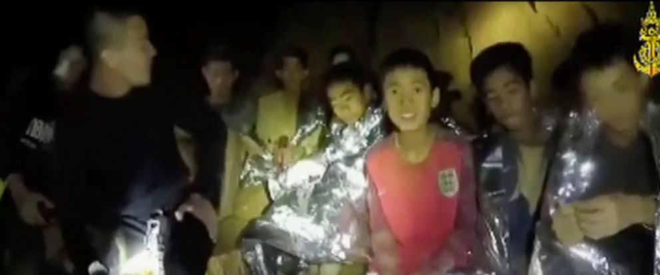

Slide 6
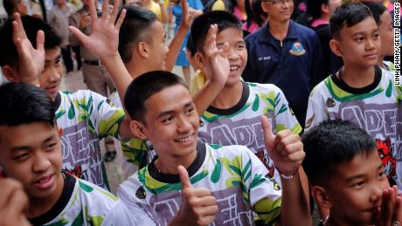

Slide 7
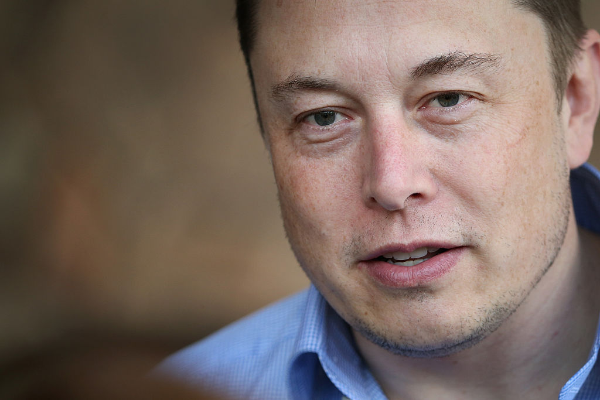

Slide 9
“When I was a child, there’s one thing I said,” Musk continues. His demeanor is stiff, yet in the sheen of his eyes and the trembling of his lips, a high tide of emotion is visible, pushing against the retaining walls. “‘I never want to be alone.’ That’s what I would say.” His voice drops to a whisper. “I don’t want to be alone.”

Slide 10
“A ring of red forms around his eyes as he stares forward and sits frozen in silence. Musk is a titan, a visionary, a human-size lever pushing forward massive historical inevitabilities, the kind of person who comes around only a few times in a century, but in this moment, he seems like a child who is afraid of abandonment. And here he sits, lonely.”

Slide 12
Psalm 142:4,6
I look for someone to come and help me,
but no one gives me a passing thought!
No one will help me;
no one cares a bit what happens to me…
Hear my cry,
for I am very low.

Slide 13
Prayer that moves us out of the cave is…
Prayer that Voices

Slide 14
Verses 1-2
I cry out to the Lord;
I plead for the Lord’s mercy.
I pour out my complaints
before him
and tell him all my troubles.

Slide 15
Prayer that moves us out of the cave is…
Prayer that Trusts

Slide 16
Verse 3
When I am overwhelmed,
you alone know the way I should
turn.
Wherever I go, my enemies have set
traps for me.

Slide 18
Prayer that moves us out of the cave is…
Prayer that Advances

Slide 19
Verses 4-5
I look for someone to come and help me,
but no one gives me a passing thought!
No one will help me;
no one cares a bit what happens to me.
Then I pray to you, O Lord.
I say, “You are my place of refuge.
You are all I really want in life.

Slide 20
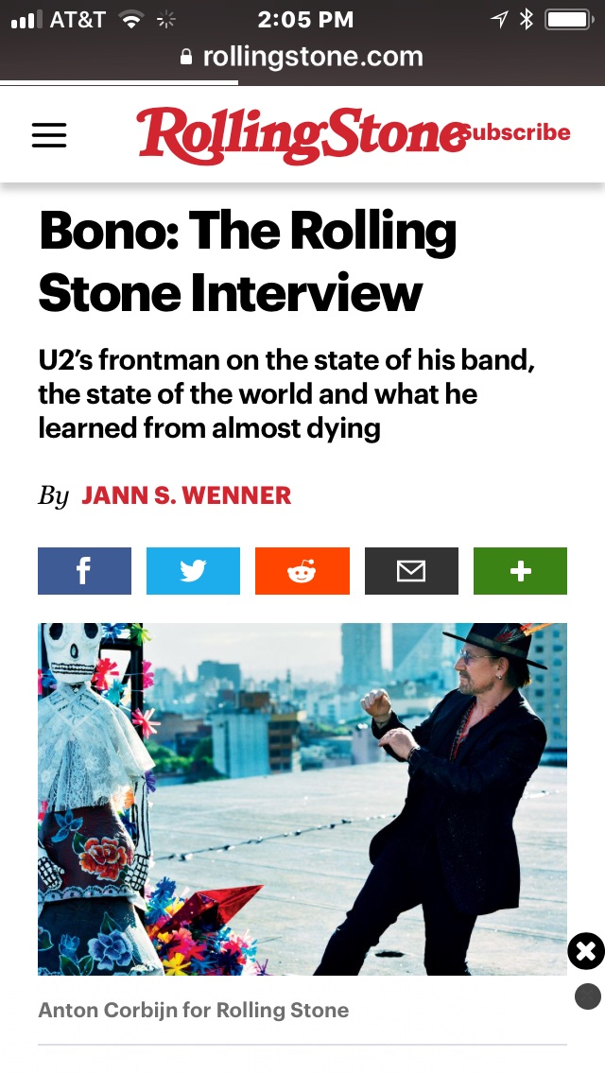

Slide 21
In the darkness of that cave, in the silence and the fear and probably the stink, he writes the psalm. As an artist, I have learned that sometimes you have to be in that cave of despair to be inspired, enlightened, and energized towards a new birth in your life.”
-- Bono

Slide 22
Prayer that moves us out of the cave is…
Prayer that Anticipates

Slide 23
Verses 6-7
Hear my cry,
for I am very low.
Rescue me from my persecutors,
for they are too strong for me.
Bring me out of prison
so I can thank you.
The godly will crowd around me,
for you are good to me.”

Slide 25
