Slide 2
Acts 1:7-9
“It is not for you to know the times or periods that the Father has set by his own authority. ⁸ But you will receive power when the Holy Spirit has come upon you; and you will be my witnesses in Jerusalem, in all Judea and Samaria, and to the ends of the earth.” ⁹ When he had said this, as they were watching, he was lifted up, and a cloud took him out of their sight.”

Slide 4
Acts 2:1-2a
“When the day of Pentecost had come, they were all together in one place. And suddenly from heaven there came a sound like the rush of the violent wind, and it filled the entire house.”

Slide 6
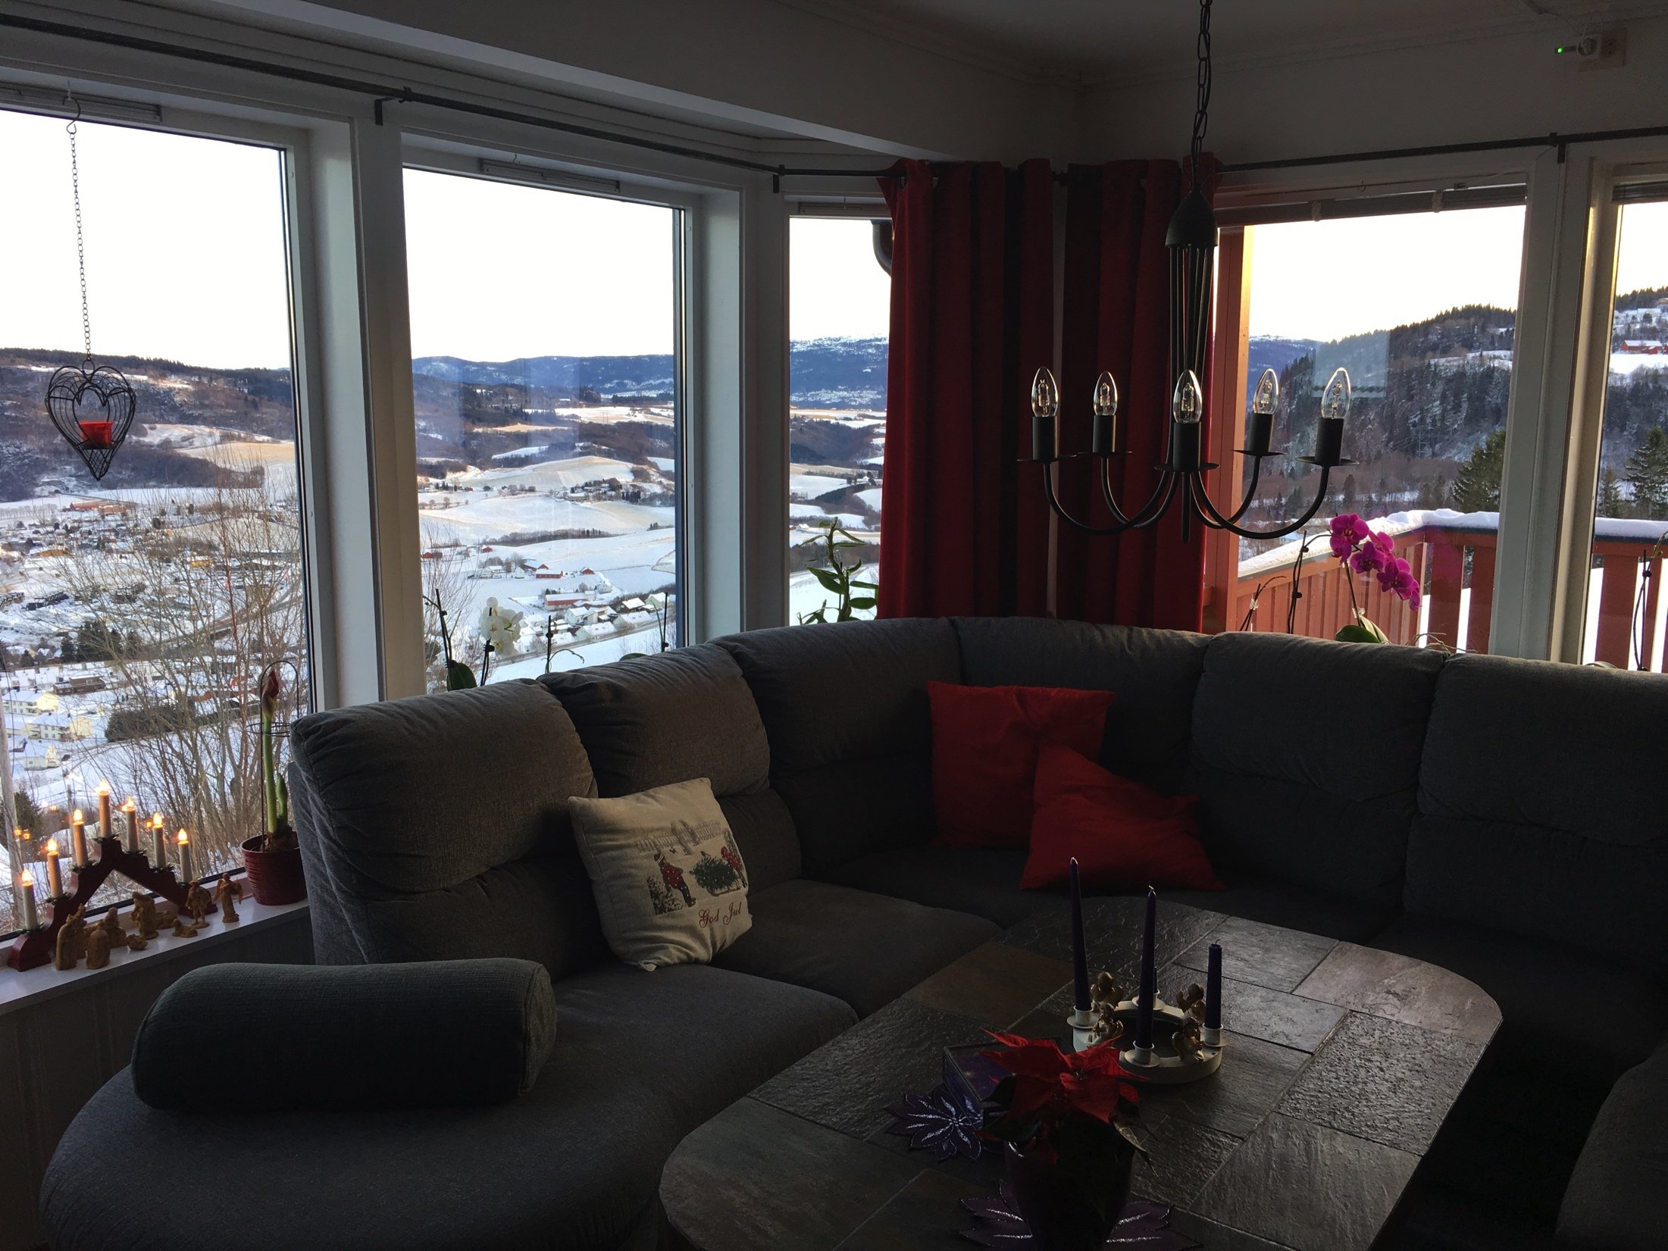

Slide 7
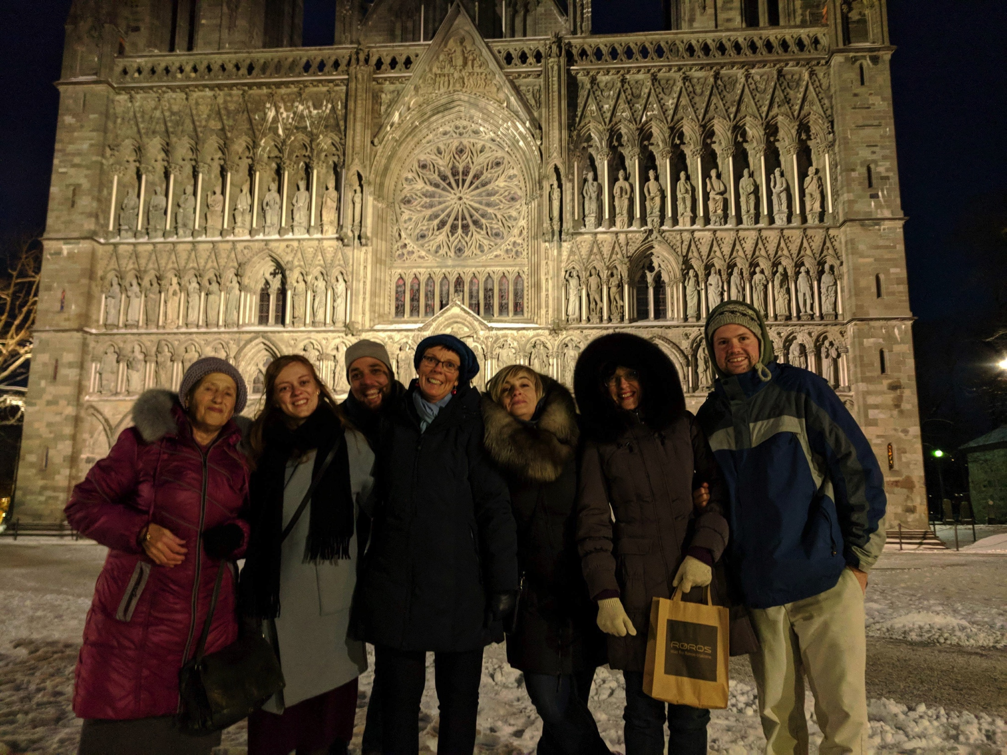

Slide 8
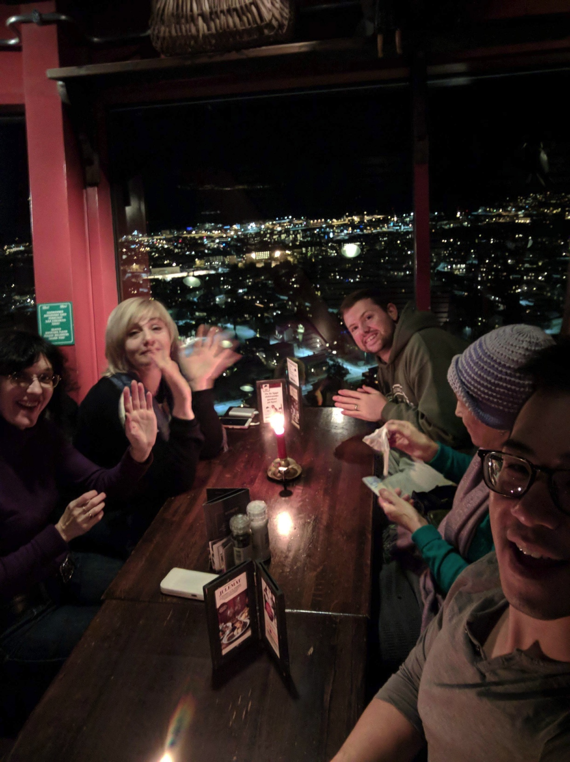

Slide 10
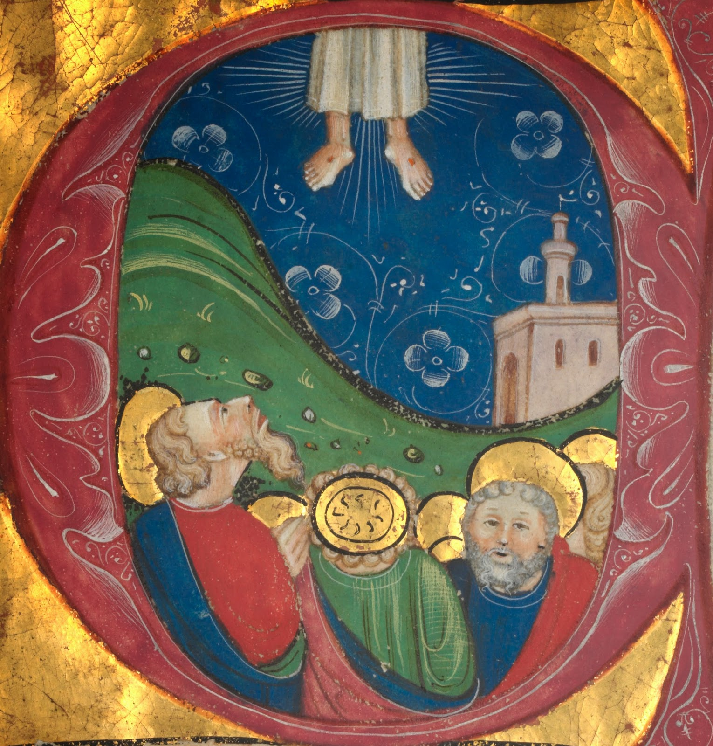

Slide 11
The Spirit is empowering us here and now.
How will we respond?

