Slide 2
From Grumbling to Grace

Slide 3
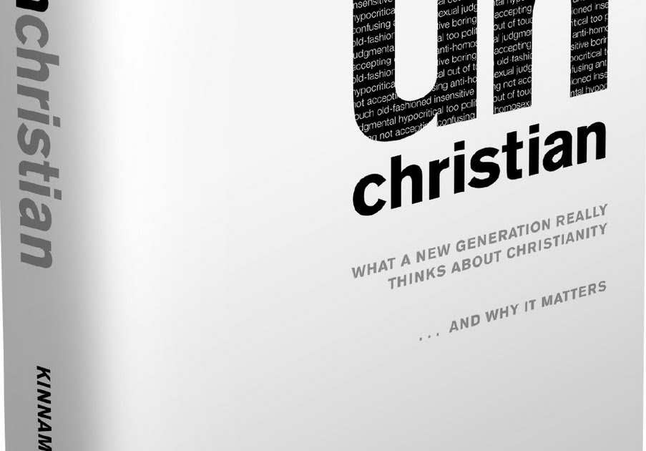

Slide 4
How those outside the church view those within:
87% said that the term "judgmental" accurately describes present-day Christianity.
84% said they personally know at least 1 committed Christian. But just 15% thought the lifestyles of those Christ-followers were significantly different from the norm.

Slide 5
Luke 15
Lost Sheep
Lost Coin
Lost Son
Lost Brother

Slide 6
The Nibbler (Sheep)

Slide 7
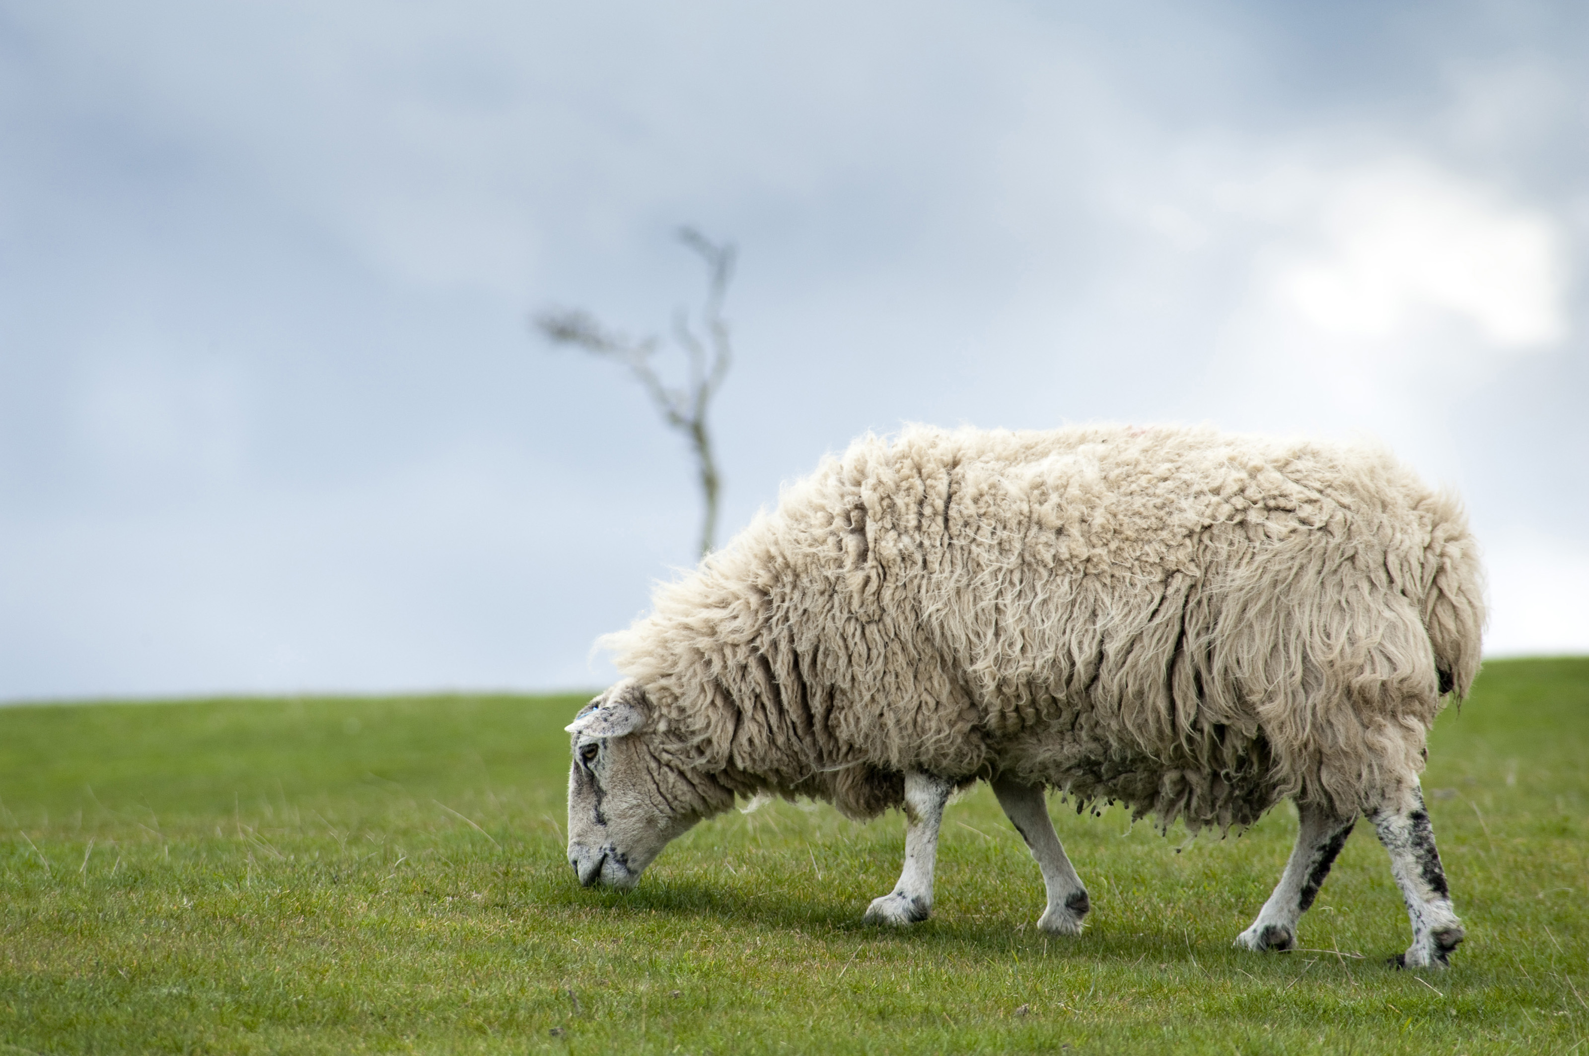

Slide 9
The Numb (Coin)

Slide 10
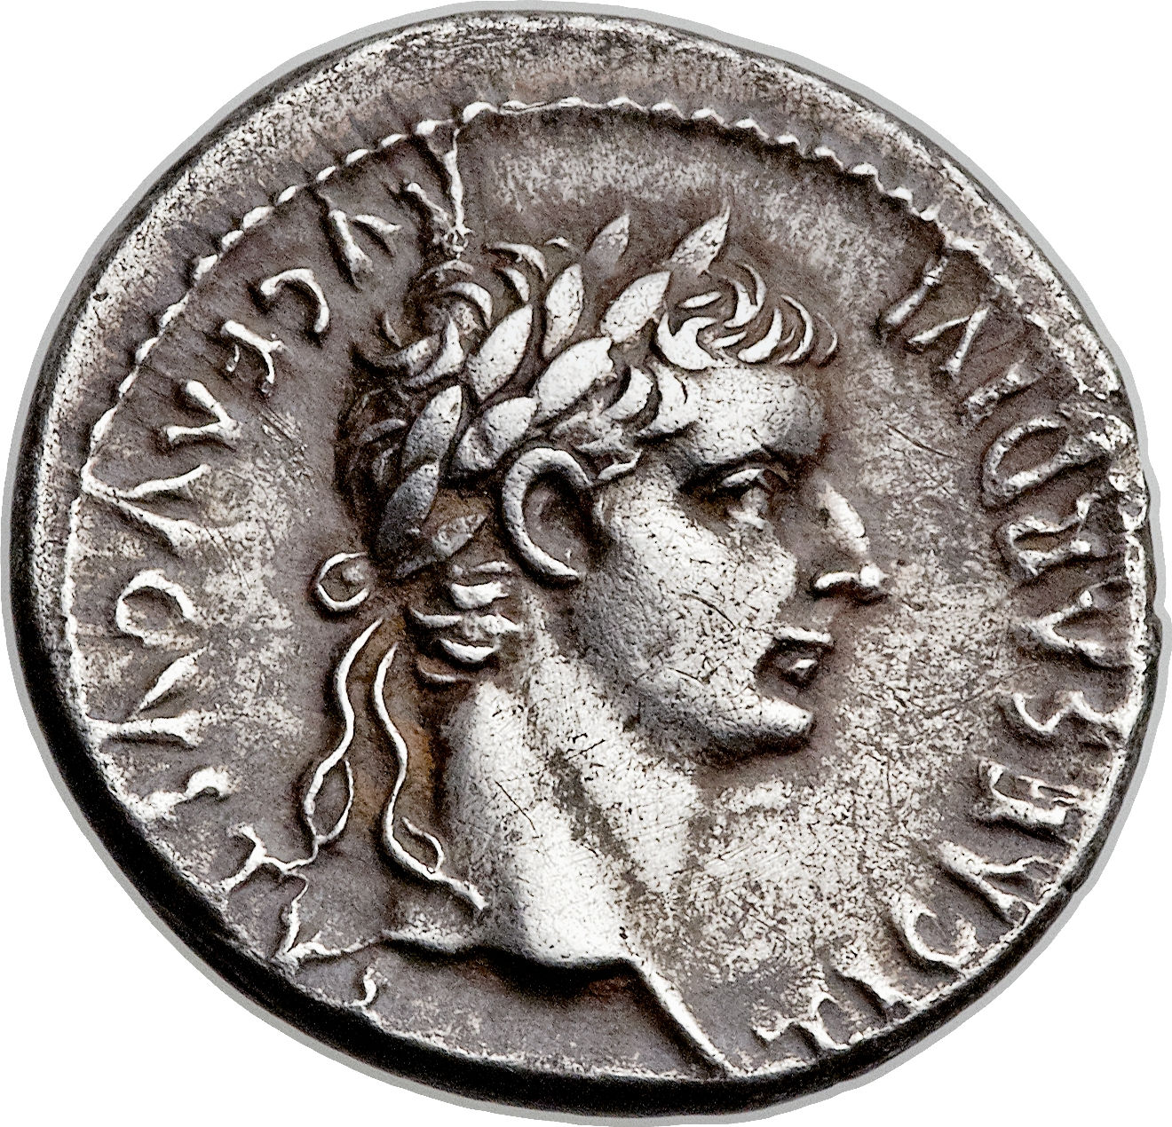

Slide 12
The No-Count (Son)

Slide 13
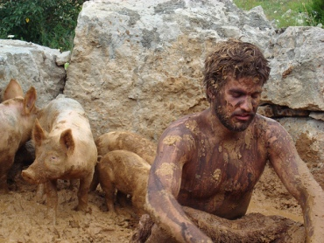

Slide 15
The Naysayer (Brother)

Slide 16
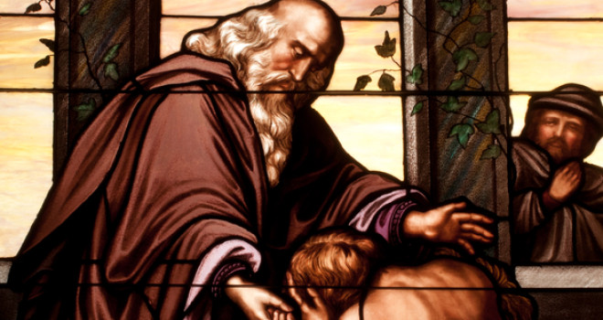

Slide 18
Most merciful God,
I confess that I have sinned against You
in thought, word, and deed,
by what I have done,
and by what I have left undone.
I have not loved You with my whole heart;
I have not loved my neighbors as myself.

Slide 19
I am truly sorry and I humbly repent.
For the sake of Your Son Jesus Christ,
have mercy on me and forgive me;
that I may delight in Your will,
and walk in Your ways,
to the glory of Your Name. Amen.

Slide 20
Grace-Givers (Servants)

Slide 21
