Slide 2
This Child will be Emmanuel Not God upon a throne
But God-with-us, Emmanuel
As close as blood and bone

Slide 3
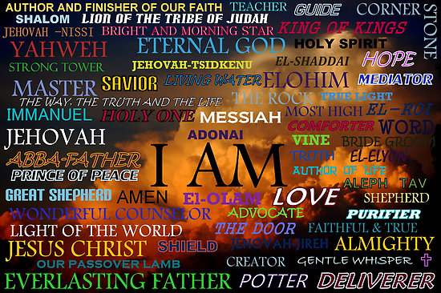

Slide 4
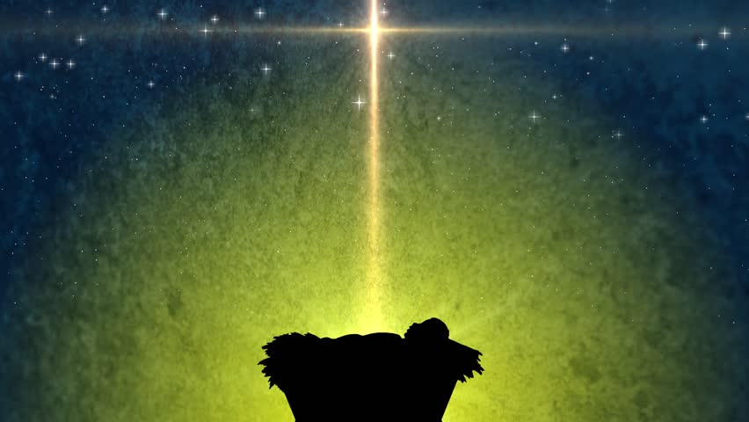

Slide 5
--The Eternal God Who confined Himself to our time.
--The Omnipresent God Who is with us through all things.
--The All-Knowing God Who is with us in our ignorance.
--The All-Powerful God Who is with us in our weakness.
--The Self-Emptying God Who emptied Himself for us.

Slide 6
Philippians 2:6-7
Though he was God,
he did not think of equality with God
as something to cling to.
Instead, he gave up his divine privileges;
he took the humble position of a slave
and was born as a human being.

Slide 8
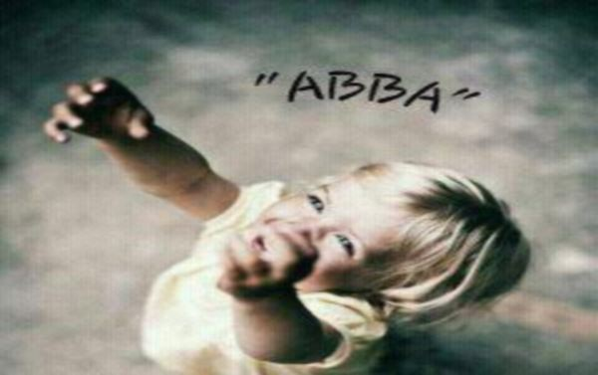

Slide 9
The tools which Joseph laid aside
A mob would later lift
And use with anger, fear and pride
To crucify God's gift.

Slide 10
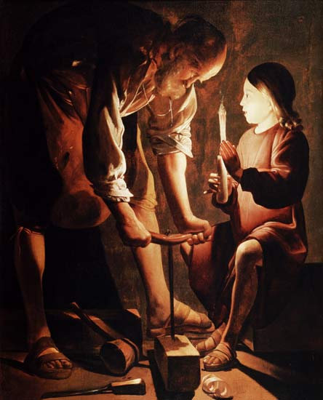

Slide 11
This Child will be Emmanuel Not God upon a throne
But God-with-us, Emmanuel
As close as blood and bone

