Slide 5
“I will not deny you in front of others”

Slide 6
Matthew 26:31a,33
Jesus told them, “Tonight all of you will desert me…Peter declared, “Even if everyone else deserts you, I will never desert you.”

Slide 7
“I will not say ‘no’ to you”

Slide 8
John 13:7-9
Jesus replied, “You don’t understand now what I am doing, but someday you will.”
“No,” Peter protested, “you will never ever wash my feet!” Jesus replied, “Unless I wash you, you won’t belong to me.”
Simon Peter exclaimed, “Then wash my hands and head as well, Lord, not just my feet!”

Slide 9
“I will not stumble as badly as others do.”

Slide 10
Mark 14:29
Peter said to him, “Even if everyone else deserts you, I never will.”

Slide 11
“I will not become lax”

Slide 12
Mark 14:37
Then he returned and found the disciples asleep. He said to Peter, “Simon, are you asleep? Couldn’t you watch with me even one hour?

Slide 13
“I will not overreact”

Slide 14
Luke 22:50-51
And one of them struck at the high priest’s slave, slashing off his right ear. But Jesus said, “No more of this.” And he touched the man’s ear and healed him.

Slide 15
“I will not deny you”

Slide 16
Mark 14:71-72
…Peter swore, “A curse on me if I’m lying—I don’t know this man you’re talking about!” And immediately the rooster crowed the second time.Suddenly, Jesus’ words flashed through Peter’s mind: “Before the rooster crows twice, you will deny three times that you even know me.” And he broke down and wept.

Slide 17
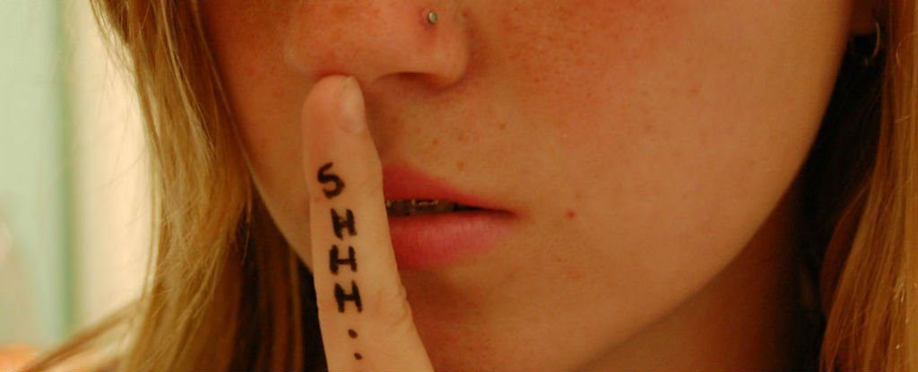

Slide 19
Psalm 38:4
My guilt overwhelms me—
it is a burden too heavy to bear.

Slide 20
The Prayer of Forgiveness

Slide 21
Luke 23:34
Jesus said, “Father, forgive them, for they don’t know what they are doing.”

Slide 22
The Prayer of Faith

Slide 23
Luke 22:31-32
“Simon, Simon, Satan has asked to sift each of you like wheat. But I have pleaded in prayer for you, Simon, that your faith should not fail. So when you have repented and turned to me again, strengthen your brothers.”

Slide 24
The Prayer of Feeding

Slide 25
John 21:17
A third time he asked him, “Simon son of John, do you love me?” Peter was hurt that Jesus asked the question a third time. He said, “Lord, you know everything. You know that I love you.”Jesus said, “Then feed my sheep.

Slide 26
The Prayer of Filling

Slide 27
John 17:13
Now I am coming to you. I told them many things while I was with them in this world so they would be filled with my joy.

Slide 30
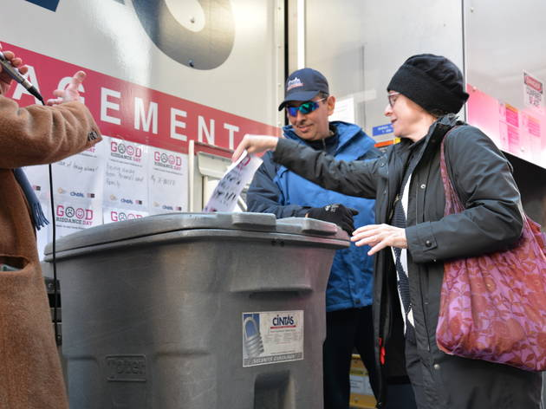

Slide 31
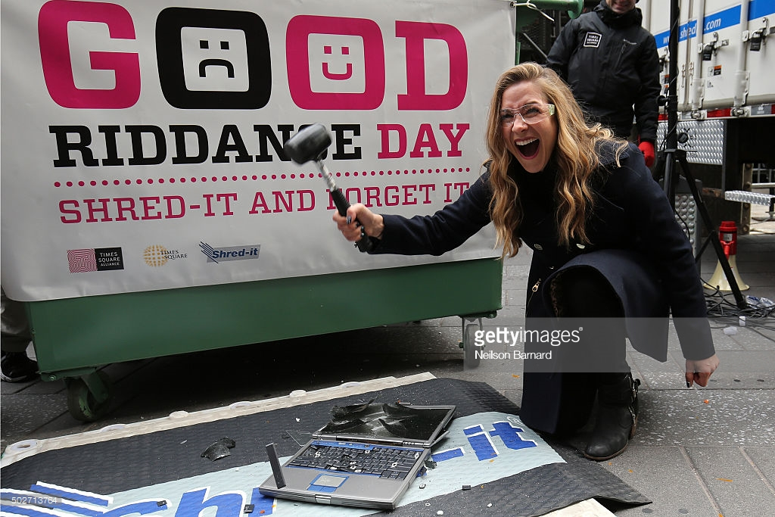

Slide 32
2 Peter 3:18
You must grow in the grace and knowledge of our Lord and Savior Jesus Christ. All glory to him, both now and forever! Amen.

