Slide 2
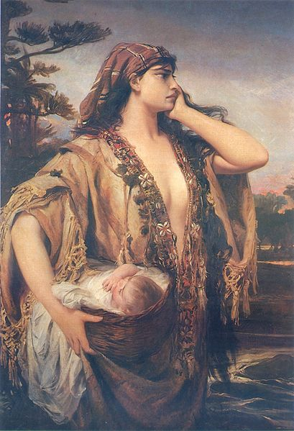

Slide 3
“With her cunning and her courage, Jochebed displays her love and her nurture of Moses by being an effective steward of time—the time she took to plan for his protection, and the time she took in Pharaoh’s house to raise him in the faith.”

Slide 5
Hebrews 11:23
It was by faith that Moses’ parents hid him for three months when he was born. They saw that God had given them an unusual child, and they were not afraid to disobey the king’s command.

Slide 9
