Slide 1
John 6:28 English & Greek Interlinear
They said to him, “What must we do, that we might work
εἶπον οὖν πρὸς αὐτόν Τί ποιοῦμεν ἵνα ἐργαζώμεθα
the works of God?”
τὰ ἔργα τοῦ θεοῦ

Slide 2
The work of God - πιστεύω
πιστεύω pisteúō, pist-yoo'-o; from G4102; to have faith (in, upon, or with respect to, a person or thing), i.e. credit; by implication, to entrust (especially one's spiritual well-being to Christ):—believe(-r), commit (to trust), put in trust with. (248x)
From πίστις noun, faith (244x)

Slide 3
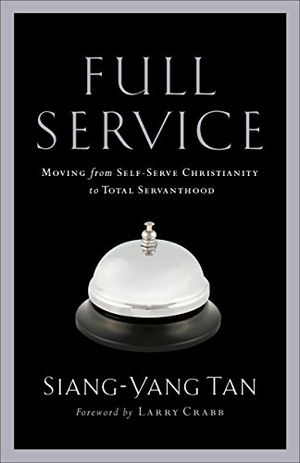
Are we in pursuit of doing great things for God or doing things for a great God?

Slide 4
My Utmost for His Highest – Oswald Chambers
“Do you Worship the Work?” – Entry for April 23
Beware of any work for God that causes or allows you to avoid concentrating on Him. A great number of Christian workers worship their work. The only concern of Christian workers should be their concentration on God. . .
Once our concentration is on God . . . There is no longer any responsibility on you for the work. You have been freed for only one thing – to be absolutely devoted to your co-Worker.

Slide 5
A quick tour of “Heroes of the Faith”

