Slide 2
“Walking in Faith”
1 John
Walking the Right Path

Slide 3
nice?
“pleasing and agreeable in nature.”

Slide 4
Walk the right path…
Away from the world

Slide 5
1 John 2:15
Do not love this world nor the things it offers you, for when you love the world, you do not have the love of the Father in you.

Slide 6
Psalm 97:10 -- You who love the Lord, hate evil!
Romans 12:9 -- Love must be sincere. Hate what is evil; cling to what is good.

Slide 7
“world” = cosmos
“system, organization”
“a way of thinking”

Slide 8
2 Timothy 4:9-10
Do your best to come to me quickly, for Demas, because he loved this world, has deserted me and has gone to Thessalonica.

Slide 11
Walk the right path…
Away from the cravings

Slide 12
1 John 2:16
For the world offers only a craving for physical pleasure, a craving for everything we see, and pride in our achievements and possessions. These are not from the Father, but are from this world.

Slide 13
“craving” = epithumia

Slide 14
John 10:10
The thief comes only to steal and kill and destroy; I have come that they may have life, and have it to the full.

Slide 15
Galatians 5:17
The sinful nature wants to do evil, which is just the opposite of what the Spirit wants. And the Spirit gives us desires that are the opposite of what the sinful nature desires. These two forces are constantly fighting each other, so you are not free to carry out your good intentions.

Slide 16
Philippians 1:21-23
For to me, living means living for Christ, and dying is even better. But if I live, I can do more fruitful work for Christ. So I really don’t know which is better. I’m torn between two desires: I long to go and be with Christ, which would be far better for me.

Slide 17
Walk the right path…
To the Eternal God

Slide 18
1 John 2:17
And this world is fading away, along with everything that people crave. But anyone who does what pleases God will live forever.

Slide 19
1 Peter 1:24-25
“People are like grass;
their beauty is like a flower in the field.
The grass withers and the flower fades.
But the word of the Lord remains forever.”

Slide 20
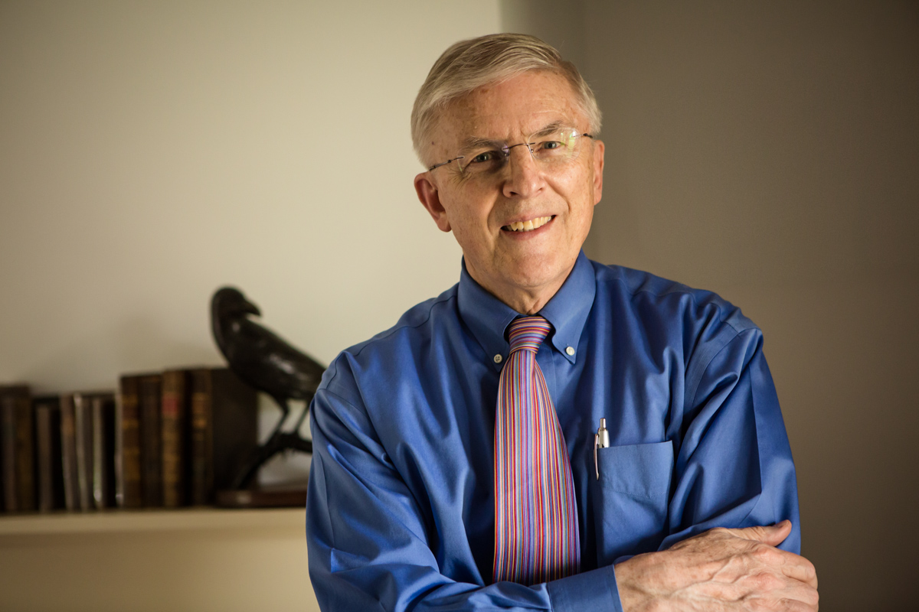

Slide 23
Verse 15
Pleasure
Pride
Possessions

