Slide 2
Matthew 1:3, 5-6
Judah the father of Perez and Zerah, whose mother was Tamar…
Salmon the father of Boaz, whose mother was Rahab,
Boaz the father of Obed, whose mother was Ruth…
David was the father of Solomon, whose mother had been Uriah’s wife…

Slide 3
“The first members of the Pentz family arrived on our American shores about the time of the American Revolutionary War…
to fight on the side of the British as Hessian mercenary soldiers."

Slide 4
Genesis 2:15-17
The Lord God took the man and put him in the Garden of Eden to work it and take care of it. And the Lord God commanded the man, “You are free to eat from any tree in the garden; but you must not eat from the tree of the knowledge of good and evil, for when you eat from it you will certainly die.”

Slide 5
Genesis 3:4-5
“You will not certainly die,” the serpent said to the woman. “For God knows that when you eat from it your eyes will be opened, and you will be like God, knowing good and evil.”

Slide 6
Matthew 1:1 (Literal Greek)
The book of the genesis of Jesus Christ, son of David, son of Abraham…

Slide 7
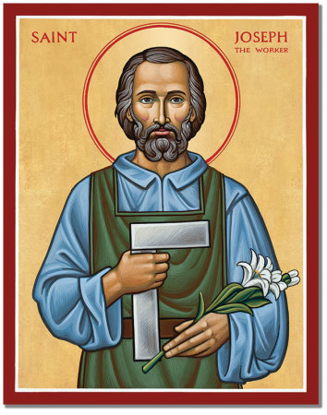
Joseph, to whom she was engaged, was a righteous man and did not want to disgrace her publicly, so he decided to break the engagement quietly. Matthew 1:19

